Slide 1
Student Loan Applications
SLC - Student Finance: Get ready for the launch

Slide 2
Session Content
With the value of higher education courses and student concerns over cost of living fully in the spotlight, this
workshop will provide an insight into the core numbers and highlight any noticeable trends behind student
loan applications across recent academic years:
Content will cover the following areas of higher education funding applications received by SLC:
National and Regional Application Figures
Application Deadlines and Submission Monitoring
Category Specific Application Numbers and Key Messages
Supporting Guidance and Money Management Resources for Students
Notes:
Student Loan Applications: A look behind the headlines.
With the value of higher education courses and student concerns over cost of living fully in the current spotlight, this workshop will provide an overview and insight into the core numbers and any noticeable trends behind student loan applications across recent academic years.
Delegates will be presented with the latest available breakdown of student finance application numbers across a variety of categories and will have to opportunity to discuss their experiences of student attitudes toward taking loans, the perceived spectre of ‘debt’ they carry and the persistent issue SLC face of ‘late’ application submission and what, if anything can be done to address this issue.

Slide 3
Student Finance Facts and Figures
Loan Balance and Payments

Slide 4
Student Loans: Outstanding Overall Balance
What was the total outstanding balance for Income Contingent (ICR) student loans at the end of
financial year 2023-24?
£240.8bn
£260.8bn
£250.8bn
£260.8bn
Figures from: www.gov.uk/government/collections/student-loans-for-higher-and-further-education

Slide 5
Student Loans: Outstanding Balance Facts
Total balance of ICR student loans by financial year and the government administration funding
the loan 2016-17 to 2023-24 (£ billions):
FE borrowers (Advanced Learner Loans) in England equate for approximately £1.8bn of the overall £260.8bn balance of the student loan book
Financial Year | 2016-17 | 2017-18 | 2018-19 | 2019-20 | 2020-21 | 2021-22 | 2022-23 | 2023-24
England (HE) | £89.3 | £104.5 | £121.8 | £140.1 | £160.6 | £181.6 | £205.6 | £236.2
Wales | £3.7 | £4.1 | £4.7 | £5.3 | £6.2 | £7.1 | £8.0 | £9.3
Northern Ireland | £3.0 | £3.3 | £3.6 | £3.8 | £4.1 | £4.4 | £4.7 | £5.1
Scotland | £4.5 | £5.0 | £5.5 | £6.0 | £6.5 | £7.0 | £7.6 | £8.4
UK Total | £101.1 | £117.7 | £136.7 | £156.5 | £178.8 | £201.6 | £227.5 | £260.8

Slide 6
Student Loans: Overpayment Summary
The total amount over-repaid in financial year (FY) 2023-24 was £23.3 million, of which £21.7 million (93.0%) has been refunded to the customer (an average of £920 per customer).
Of the remaining refunds pending, the average refund is £50.
The total over-repaid amount represents 0.4% of the total repayments made in FY 2023-24 and 0.01% of the total loan book balance at 31 March 2024, with the amount over-repaid being reduced by 56.5% in six-year period.
Over-repayments are entirely avoidable if customers join the direct debit scheme in the final stages of their loan term
Over-repayment of income contingent loans through PAYE: FY15-16 to 23-24 - GOV.UK
Notes:
If a student has had no contact or limited contact (verbal or written) with their biological/adoptive parent(s) & no longer have what they would class as a supportive relationship for any amount of time, they can be assessed as an independent student on the basis of estrangement.
For a limited amount of contact to be considered SLC would need a full explanation on the nature of the contact they have had and this would then be assessed on a case by case basis.
Students who have a legal guardian should also apply as an estranged student.
A legal guardianship / court order would not be sufficient evidence as this does not confirm the current situation with the student’s parents.
The legal guardian is not able to act as a sponsor on the student’s application.
If the student has been legally adopted, then SLC would require their adoptive parents to provide their income details in support of the application.

Slide 7
Student Loan Applications
National and Regional Figures
Note: All application and year-on-year comparison data used is as of 10th June 2024

Slide 8
The Student Loans Company: Application Services
SLC provide financial services (in the form of loans and grants) to over 2 million new and returning students
annually, in colleges and universities across England, Northern Ireland, Scotland and Wales:
SLC have over 9.4 million ‘customers’ and manage a loan book, currently worth £260.8bn
SLC application and payment service delivery summary:
Manage the full ‘apply, assess, pay and repay’ process for undergraduates in England and Wales
Provide the payment and repayments services for Scotland and Northern Ireland and maintain the assessment systems and portals used for applications and assessments in Northern Ireland
Manage a range of FE, HE and Postgraduate funding products, targeted support grants and services, tailored to the differing requirements of UK Government Administrations
The following slides will present a ‘snapshot’ summary of undergraduate student finance applications and
provide additional commentary to add context to the figures, processes and SLC messaging
For more information on the roles and responsibilities of SLC go to: www.gov.uk/government/organisations/student-loans-company/about
Notes:
SLC play a central role in supporting the higher education (HE) and further education (FE) sectors. We do this by making timely and accurate payments of Maintenance Loans to learners and Tuition Fee Loans to HE and FE providers.
SLC work with the Department for Education (DfE, England), and the devolved administrations in Scotland, Northern Ireland and Wales. We also work with the Student Awards Agency for Scotland (SAAS), the Education Authority for Northern Ireland (EANI), HE and FE providers and other delivery partners.
SLC provide financial services (in the form of loans and grants) to over 2 million new and returning students annually, in colleges and universities across England, Northern Ireland, Scotland and Wales.
SLC have 9.4 million customers and manage a loan book worth £227.5bn.
SLC Delivery Summary:
manage the full end-to-end ‘apply, assess, pay and repay’ process for undergraduates in England and Wales and provide the payment and repayment parts of this service for Scotland and Northern Ireland; SLC also maintain the assessment systems and online portals used for applications and assessments in Northern Ireland
manage a range of FE and Postgraduate products and services that are tailored to the differing requirements of Government Administrations, alongside various “targeted support” grants to enable people to overcome barriers to participation in FE and HE
administer bursary payments on behalf of many UK HE providers
work with HMRC to collect repayments through PAYE and self-assessment systems while directly collecting from borrowers outside the UK tax system or those nearing the end of their repayment term.

Slide 9
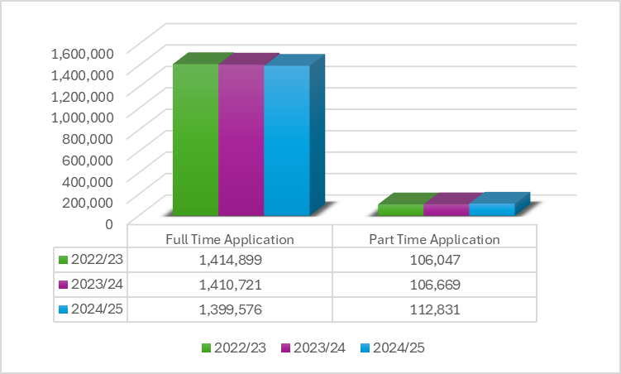
Undergraduate Applications: A National Picture
Each academic year, SLC will receive, assess and process over 1.5 million applications for full-time and
part-time undergraduate student finance products:
Academic Year | Full-Time | Part-Time
22/23 | 1,414,899 | 106,047
23/24 | 1,410,721 | 106,669
24/25 | 1,399,576 | 112,831
Application data YoY comparison (As of 31st March 2025)

Slide 10
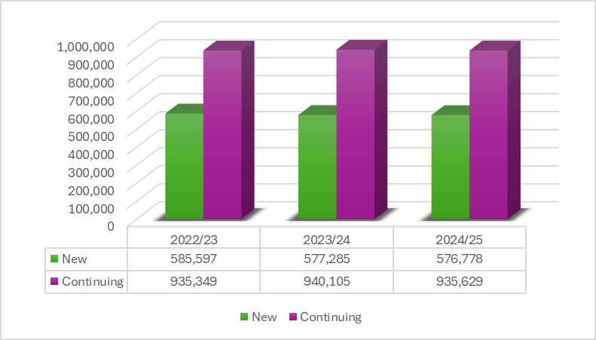
Undergraduate Applications: New and Continuing
The applications received will be made up of new students, often undertaking their first higher education
course and continuing students who are returning for their next academic year of study:
Academic Year | New | Continuing
22/23 | 585,597 | 935,349
23/24 | 577,285 | 940,105
24/25 | 576,778 | 935,629
Application data YoY comparison (As of 31st March 2025)

Slide 11
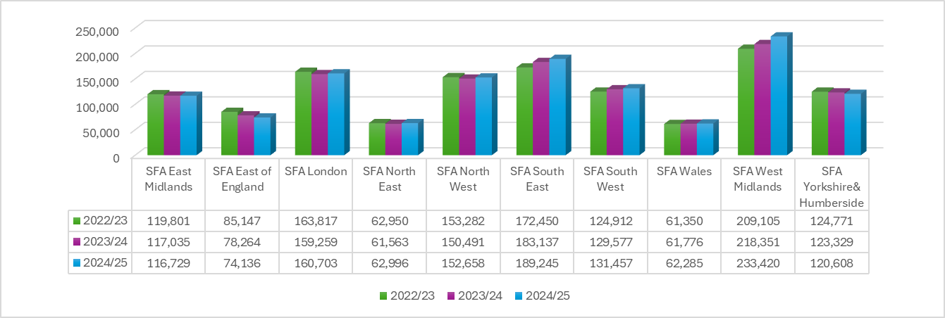
Undergraduate Applications: Regional Focus
Regional application figures can be used to monitor the overall submission figures for specific geographical
areas but also allow for the identification of any spikes or drops in numbers that may warrant investigation:
Application data YoY comparison (As of 31st March 2025)

Slide 12
Undergraduate Applications: Regional Engagement
Having access to regional application submission figures allows the SLC Funding Information Services Team
to deliver targeted and bespoke IAG messages and training update sessions to their partner network:
Academic Year | East Midlands | East of England | London | North East | North West
22/23 | 119,801 | 85,147 | 163,817 | 62,950 | 153,282
23/24 | 117,035 | 78,035 | 159,259 | 61,563 | 150,491
24/25 | 116.729 | 74,136 | 160,703 | 62,996 | 152,658
Academic Year | South East | South West | Wales | Midlands | Yorkshire & Humberside
22/23 | 172,450 | 124,912 | 61,350 | 209,105 | 124,771
23/24 | 183,137 | 129,577 | 61,776 | 218,351 | 123,329
24/25 | 189,245 | 131,457 | 62,285 | 233,420 | 120,608
Application data YoY comparison (As of 31st March 2025)

Slide 13
Student Loan Applications
Deadlines and Submission Monitoring
Note: All application and year-on-year comparison data used is as of 10th June 2024

Slide 14
Application Submission: Student Messages
The full-time undergraduate application services for AY 2025/26 are open and to support students through
this process, key messages are published on SLC’s student facing websites and social media channels:
For example, the key messages for full-time SFE undergraduate applications include:
To set up your online account and apply, go to: www.gov.uk/apply-online-for-student-finance
You do not need a confirmed place at university or college to apply
Apply with your preferred choice, you can change the details later if necessary
Make sure any evidence and information needed to support your application is supplied ‘right first time’ both from you and your parents (or partner)
Read, understand and agree to the loan Terms and Conditions
i
If you cannot apply online, you will be directed to the appropriate paper form to complete
and submit: www.gov.uk/student-finance-forms
Notes:
Other notes of importance for students;
Make a note of your account log-in details and keep them safe
Agree to share information from your application, this helps apply for many bursaries and some scholarships
Make sure any evidence and information needed to support your application is supplied first time (yours and your parent/partners’)
Submit your application even if there is a delay in getting income details from your parent/sponsor so some funding (Tuition and Maintenance Loan) will be available when you start your course
If SFE ask you to send any additional evidence or documents to support your application use the digital upload function from your online account or recorded delivery!
Before starting the application, students should have the following to hand:
• Passport - SLC can check identity using valid UK passport details for most students
• University and course details – Remember apply with your first choice initially so your application can be assessed as soon as possible
• Bank account details
• National Insurance number
• Parent’s or partner’s National Insurance number and income details

Slide 15
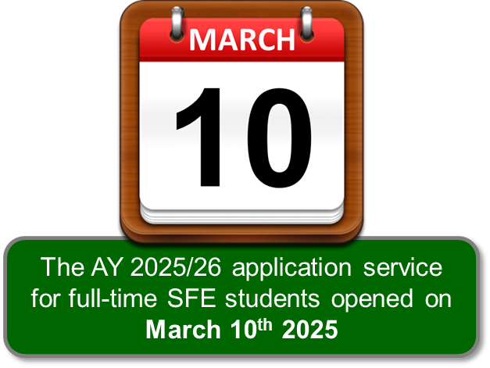
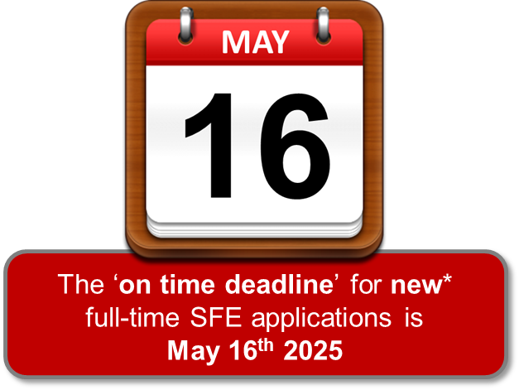
Application Submission: Deadline Dates
The full-time undergraduate application services for AY 2025/26 are now open and, if they want their funding
paid at the start of the academic year, it is important students apply before (or close to) the set deadlines:
Funding Administration | New Student Deadline | Continuing Student Deadline
SFW | May 31st | June 28th
SFNI | April 30th | June 28th

Slide 16
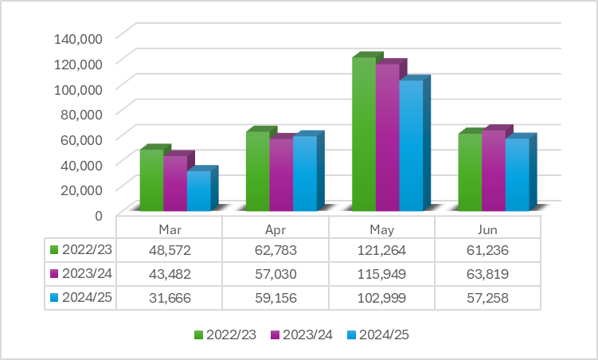
Application Submission: On-Time AY 2024/25
After a slow March, submission levels picked up across the remainder of the ‘on-time’ period, with 162,155 new
full-time undergraduate student finance applications received across April and May 2024:
Application data YoY comparison (As of 31st March 2025)

Slide 17
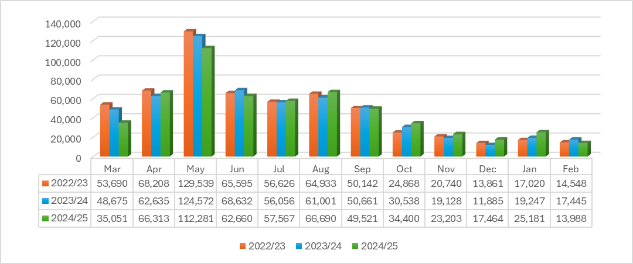
Application Submission: Post-Deadline
Despite online campaigns, reminder prompts and IAG practitioner engagement, each academic year sees a
significant number of students submit their funding applications after the set ‘deadlines’:
New Student Applications Post-New FT Deadline
Application data YoY comparison (As of March 31st 2025)

Slide 18
Application Submission: Year-on-Year Comparison
The stark reality is that the later a student leaves it to submit their application, the more risk they run of not
receiving their full payments at the start of their course or when returning for the next year of study:
Academic Year | March | April | May | June | July | August
22/23 | 53,690 | 68,208 | 129,539 | 65,595 | 56,626 | 64,933
23/24 | 48,675 | 62,635 | 124,572 | 68,632 | 56,056 | 61,001
24/25 | 35,051 | 66,313 | 112,281 | 62,660 | 57,567 | 66,690
Academic Year | September | October | November | December | January | February
22/23 | 50,142 | 24,868 | 20,740 | 13,861 | 174,020 | 14,548
23/24 | 50,661 | 30,538 | 19,128 | 11,885 | 19,247 | 17,445
24/25 | 49,521 | 34,400 | 23,203 | 17,646 | 25,181 | 13,988
Application data YoY comparison (As of 31st March 2025)

Slide 19
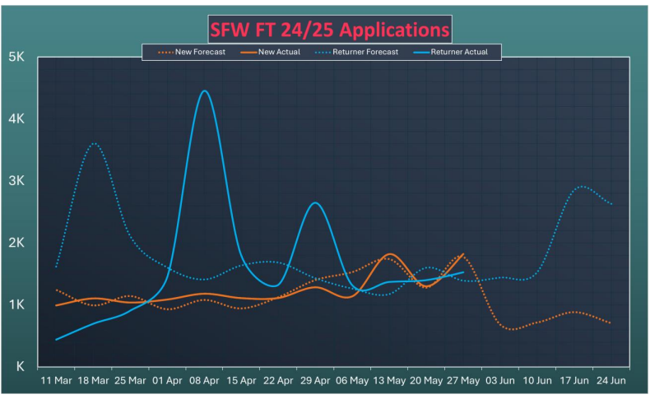
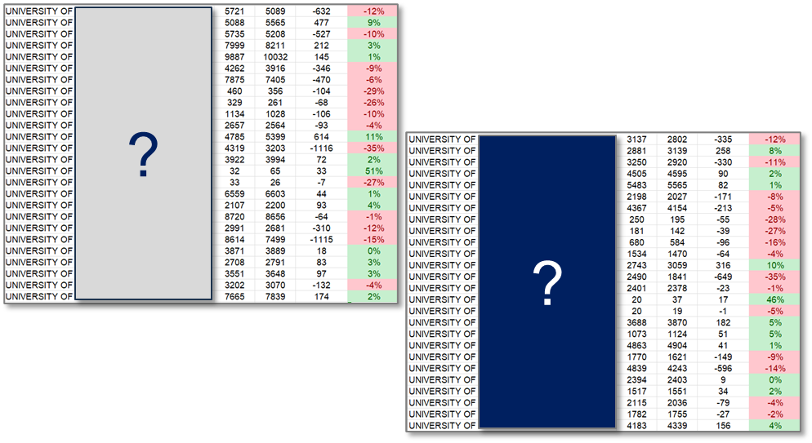
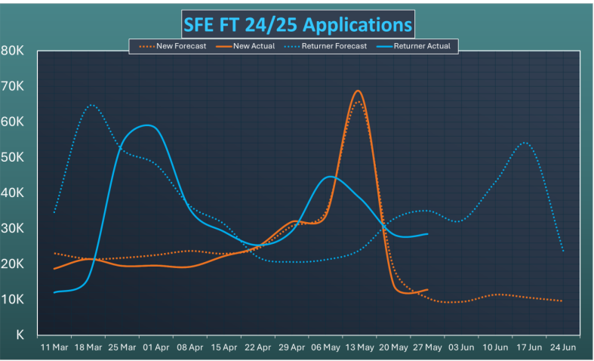
Application Submission: Forecasts and Tracking
For each academic year, funding domicile and product specific application numbers are forecast, plotted and
monitored against actual submissions, which can inform reactive communication campaigns:
Tracking year-on-year figures at an individual provider level allows for targeted IAG messages or additional awareness raising support to be delivered if required

Slide 20
Student Loan Applications
Category Specific Numbers and Messages
Note: All application and year-on-year comparison data used is as of 10th June 2024

Slide 21
Category Specific Applications
The range of support available to students and the associated eligibility policies extend to include targeted
grants and funding for applicants who fall into defended categories and criteria:
These categories include:
• Students with children or adult dependants’
Students with disabilities, long-term health conditions, mental-health conditions or specific learning difficulties
• Independent students including Care Leavers and those irreconcilably estranged from their parents
Students eligible for funding under any of the ‘protected’ residency statuses
SLC’s Charter for Customers who Require Additional Support details how SLC is committed to better understanding
vulnerability and additional support needs, and to improve the service provided to customers who require the most help:
www.gov.uk/government/publications/our-commitment-to-supporting-customers-who-need-additional-support
Notes:
Introducing SLC’s Charter for Customers who Require Additional Support
SLC are committed to growing our understanding of vulnerability and additional support needs, as well as continually improving the service we provide to customers who require the most help.
We’ve developed our Charter and approach with input from stakeholders and experts including our independent Vulnerable Student Stakeholder Group and the Money Advice Trust. We are grateful for their support and will continue to seek their thoughts and views as we move forward.
We’ve also worked with SLC’s Customer Panel who continue to make a really important contribution to this work.
A student is considered independent if:
They’ve been married or formed a civil partnership before the start of the academic year even if that marriage or civil partnership has ended
• They have no living parents
• They’ve supported themselves for at least three years before the start of their course
They’ve not communicated with their parents for one year before the beginning of the academic year for which they are applying for support, or can demonstrate a permanent estrangement from their parents
Their parents cannot be traced or it is not practical or possible to contact them
Their parents live outside of the EC and an income assessment would put them in jeopardy, or if not reasonably practicable for them to send funds to the UK if a contribution were assessed
Subject to certain exceptions, they were looked after by a local authority throughout any three month period ending on or after the date on which they turned 16 and before the first day of the first academic year of their course
A student can also be considered independent if they supported themselves financially for at least three years prior to the start of their course.
The three years can include periods when they were:
In paid full-time employment
In receipt of Income Support, JSA or other state benefits paid to a person who is registered as unemployed
In receipt of incapacity benefits, invalidity pension or maternity allowance
Receiving training under any scheme for the unemployed or other funding by any state authority or agency
The three years of self support do not need to be consecutive.

Slide 22
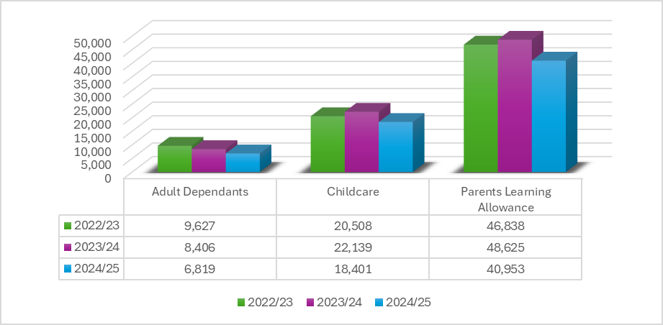
Grants for Dependants’ Applications
Grants for Dependants are available to help eligible undergraduate students pay for registered childcare
provision and help with associated costs of being a student with children or a financially dependent adult:
Application data YoY comparison (As of 31st March 2025)
Notes:
SFE GRANT IN RESPECT OF AN ADULT DEPENDANT.
Where applicable, the maximum grant in 2024/25 in respect of one dependant of the student who is either the student’s partner or an adult dependant will be £3,438.
“Partner” is currently defined in the Student Support Regulations. A student’s spouse or civil partner would fall within the definition. In certain cases, a person living with the student as if he were the student’s spouse or civil partner will also be covered.
Where the student does not have a partner within the meaning of the Regulations, a student may be eligible for this grant in respect of one adult dependant whose net income does not exceed £3,796.
SFE GRANT TOWARDS CHILDCARE COSTS (CHILDCARE GRANT).
The amount of childcare grant payable in 2024/25 will be based on 85% of actual childcare costs, subject to a maximum grant of £193.62 per week for one child only or £331.95 per week for two or more children.
SFE PARENTS’ LEARNING ALLOWANCE.
The maximum amount of Parents’ Learning Allowance payable in 2024/25 will be £1,963 and the minimum £50.

Slide 23
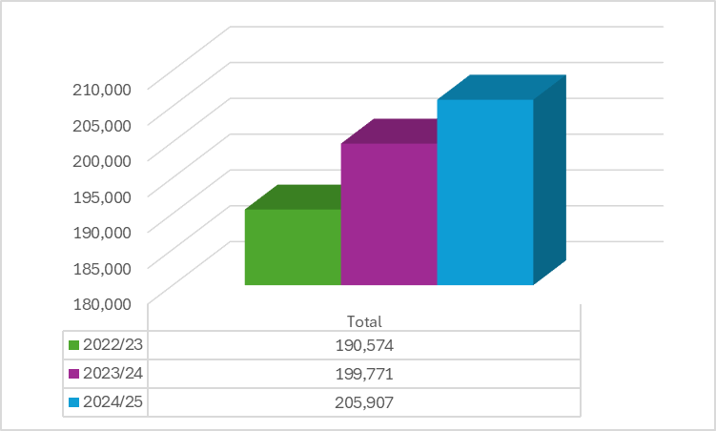
Disabled Students’ Allowance Applications
Disabled Students’ Allowance provides help towards the additional costs a student could face as result of their
disabilities, long-term health condition, mental-health condition or specific learning difficulty:
Academic Year | DSA Applications
22/23 | 190,574
23/24 | 199,771
24/25 | 205,907
Application data YoY comparison (As of 31st March 2025)
Notes:
A grant to help eligible students pay for any extra essential study costs they may have as a direct result of their disability, helping to enable opportunity by widening access and participation in higher education.
Students can get help with the costs of:
specialist equipment, for example a computer with assistive technology software or specialist ergonomic furniture
non-medical help (NMH), for example a specialist mentor, specialist notetaker or a British Sign Language (BSL) interpreter
additional transportation costs to attend their course
other disability related study support, for example additional printing costs

Slide 24
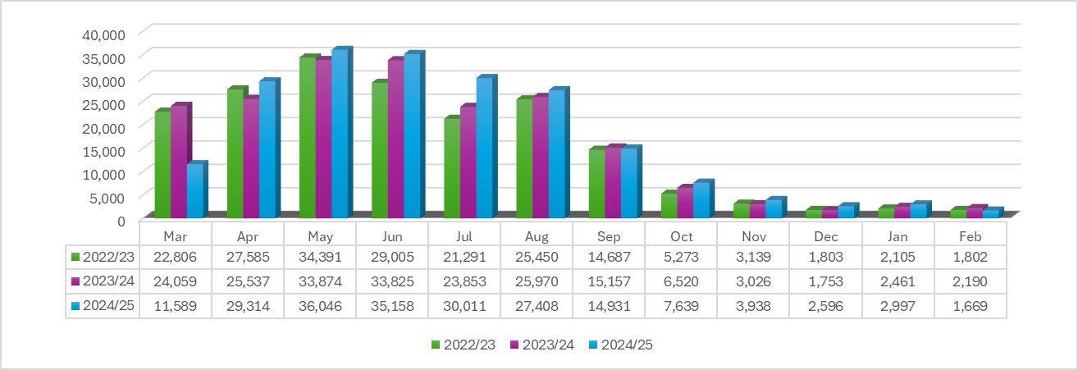
DSA Applications: Year-on-Year Comparison
It can take up to 14 weeks for DSA support to be put in place, so it is essential that students are aware of the
application process as early as possible to avoid delays in accessing the equipment and help they need:
Applications Post-New FT Deadlines
Application data YoY comparison (As of 31st March 2025)
Notes:
A grant to help eligible students pay for any extra essential study costs they may have as a direct result of their disability, helping to enable opportunity by widening access and participation in higher education.
Students can get help with the costs of:
specialist equipment, for example a computer with assistive technology software or specialist ergonomic furniture
non-medical help (NMH), for example a specialist mentor, specialist notetaker or a British Sign Language (BSL) interpreter
additional transportation costs to attend their course
other disability related study support, for example additional printing costs

Slide 25
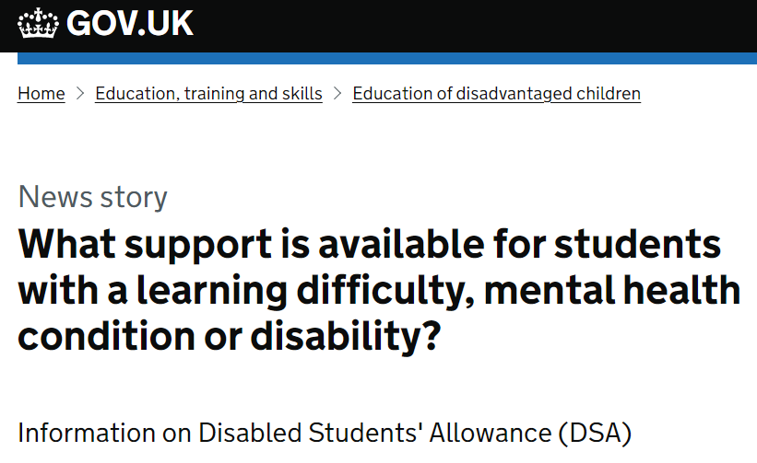
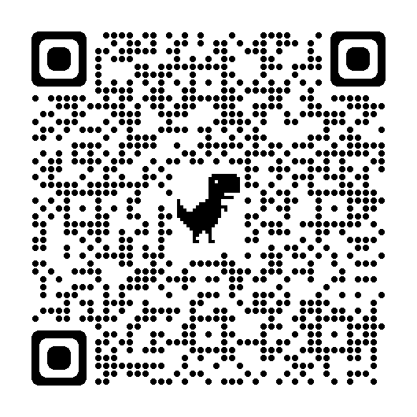
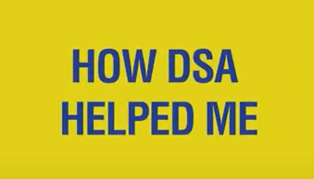
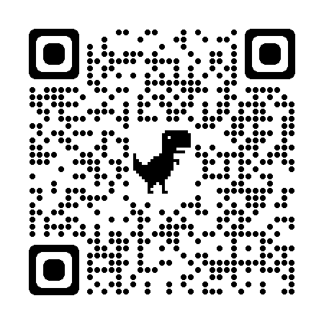
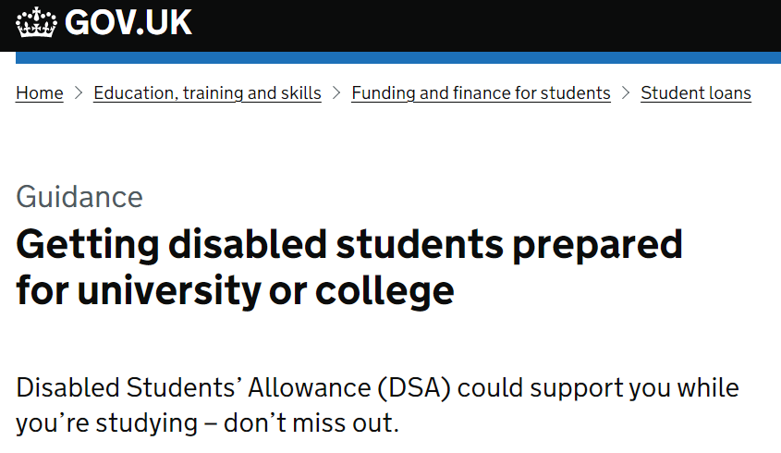
DSA Support: Guidance and Resources
Guidance has been added to GOV.UK, and a focused social media campaign and playlist of DSA Experience
films have been introduced to help students to gain a better understanding of DSA support and how to apply:
www.gov.uk/government/news/what-support-is-available-for-students-with-a-learning-difficulty-mental-health-condition-or-disability
www.gov.uk/guidance/getting-disabled-students-prepared-for-university-or-college
Notes:
https://www.gov.uk/government/news/what-support-is-available-for-students-with-a-learning-difficulty-mental-health-condition-or-disability
https://www.gov.uk/guidance/getting-disabled-students-prepared-for-university-or-college
Students can apply for help with their course costs through a Maintenance Loan and to cover their fees with a Tuition Fee Loan.
However, depending on a student’s circumstances, there are other types of support available as well. This includes the Disabled Students’ Allowance (DSA), which is available for students to fund extra support they may need if they are living with a disability, learning difficulty or mental health condition, including:
specific learning difficulty
mental health condition
physical disability
sensory disability
long-term health condition
We understand that personal circumstances and the support required is very individual to that student and will vary from person to person. However, in the widest terms, DSA support covers:
Specialist equipment – for example if a student needs a computer to run specialist software or braille display.
Non-medical helpers – for example, if a British Sign Language interpreter is required to attend lectures.
Travel – for example, if a taxi is needed to attend university, rather than using public transport.
A range of general costs may also be considered, related to a student’s disability.
DSA doesn’t depend on household income and doesn’t need to be repaid.
The application process:
Students can apply for DSA online if they are a full-time student in England and are applying for other support from Student Finance England at www.gov.uk/studentfinance
Where a student is not applying for any other finance from Student Finance England, they can download an application form at www.gov.uk/student-finance-forms
Information on DSA for part time courses can be found here:
Help if you’re a student with a learning difficulty, health problem or disability: Eligibility - GOV.UK (www.gov.uk) and
for post graduate courses, please visit Help if you’re a student with a learning difficulty, health problem or disability: Disabled Students’ Allowance - GOV.UK (www.gov.uk)
As part of the application process students will be required to provide evidence of their disability. For advice on what may be required www.gov.uk/disabled-students-allowances-dsas/eligibility
As part of our ongoing campaign to raise awareness of Disabled Students’ Allowance, members of the FIS Team and our Marketing Team have been working with the University of Greenwich and the initial result of this collaboration has been the creation of four short videos featuring students talking about their experiences in higher education and how DSA support has helped them with their studies.
The videos are hosted on the SFE YouTube channel, and can be viewed either individually from the main SFE video page or as part of a dedicated playlist.
https://www.youtube.com/@SFEFILM/videos
https://www.youtube.com/playlist?list=PL4wogSHG9Pv_lt3vPHNjH4Dqe00DoSzJj

Slide 26
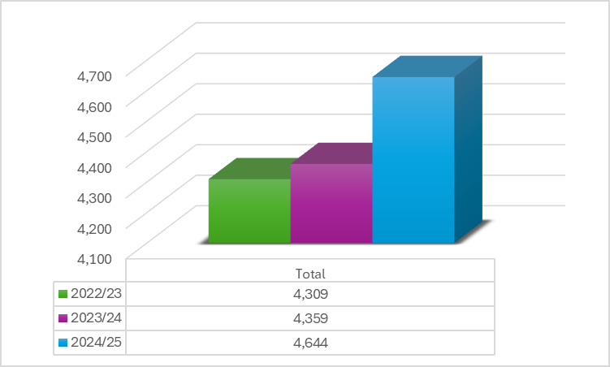
Care Leaver Applications
Students who qualify as a Care Leaver can be deemed as independent but supporting evidence such as a
letter from the relevant Local Authority, or their Social Worker will be required as part of their application:
Academic Year | Care Leaver Applications
22/23 | 4,309
23/24 | 4,359
24/25 | 4,644
Application data YoY comparison (As of 31st March 2025)
Notes:
Once awarded support due to being a care leaver this status is awarded for the duration of the student’s studies. Further evidence is therefore not required in subsequent years.
Acceptable evidence is a signed and dated letter from the council or local authority confirming the student is a Care Leaver or has left care from the local authority and also confirming:
that they were looked after by a local authority (including being in care of foster parents),
the dates they were in care which needs to cover at least 3 months between age of 16 and 1st day of 1st AY
that they have not returned to the care of their parent(s) prior to the start of their course.
The key stipulation is that the student has been placed under the care of the local authority.
Students who have been housed by private charities and other companies who house and look after students will fall under the estranged category.
If a student has returned to the legal care of their parents before the 1st day of the 1st AY of their course, they will revert to being financially dependent on parents and the relevant details will need to be provided.
If a student returns to their parents following the 1st day of the 1st AY, they have already met care leaver criteria and can retain this status.

Slide 27
Care Leaver Applications: Year-on-Year Comparison
Once a student has been assessed as being a Care Leaver, this status is awarded for the duration of their
course and further evidence will not usually be required for any subsequent years:
Applications Post-New FT Deadlines
Application data YoY comparison (As of 31st March 2025)
Notes:
Once awarded support due to being a care leaver this status is awarded for the duration of the student’s studies. Further evidence is therefore not required in subsequent years.
Acceptable evidence is a signed and dated letter from the council or local authority confirming the student is a Care Leaver or has left care from the local authority and also confirming:
that they were looked after by a local authority (including being in care of foster parents),
the dates they were in care which needs to cover at least 3 months between age of 16 and 1st day of 1st AY
that they have not returned to the care of their parent(s) prior to the start of their course.
The key stipulation is that the student has been placed under the care of the local authority.
Students who have been housed by private charities and other companies who house and look after students will fall under the estranged category.
If a student has returned to the legal care of their parents before the 1st day of the 1st AY of their course, they will revert to being financially dependent on parents and the relevant details will need to be provided.
If a student returns to their parents following the 1st day of the 1st AY, they have already met care leaver criteria and can retain this status.

Slide 28
Estranged Student Applications: Year-on-Year
If students are unable to supply standard evidence documents or if they have lost contact with their support
network due to circumstances or relocation, SLC assessors will identify these cases and offer assistance:
Applications Post-New FT Deadlines
Application data YoY comparison (As of 31st March 2025)
Notes:
If a student has had no contact or limited contact (verbal or written) with their biological/adoptive parent(s) & no longer have what they would class as a supportive relationship for any amount of time, they can be assessed as an independent student on the basis of estrangement.
For a limited amount of contact to be considered SLC would need a full explanation on the nature of the contact they have had and this would then be assessed on a case by case basis.
Students who have a legal guardian should also apply as an estranged student.
A legal guardianship / court order would not be sufficient evidence as this does not confirm the current situation with the student’s parents.
The legal guardian is not able to act as a sponsor on the student’s application.
If the student has been legally adopted, then SLC would require their adoptive parents to provide their income details in support of the application.

Slide 29
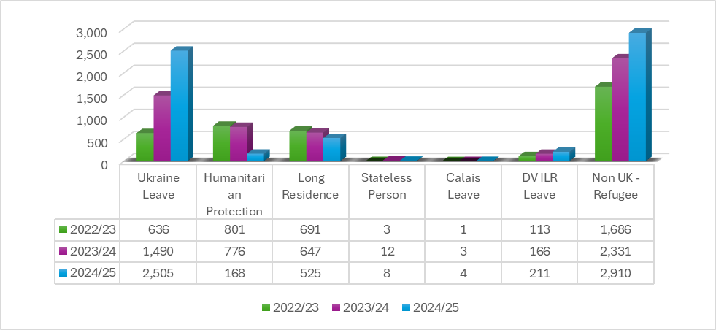
Residency Status Applications
Global events and government responsibilities have resulted in review of and where necessary, extension to
protected residency statuses that convey eligibility to UK home fee status and student finance support:
Application data YoY comparison (As of 31st March 2025)

Slide 30
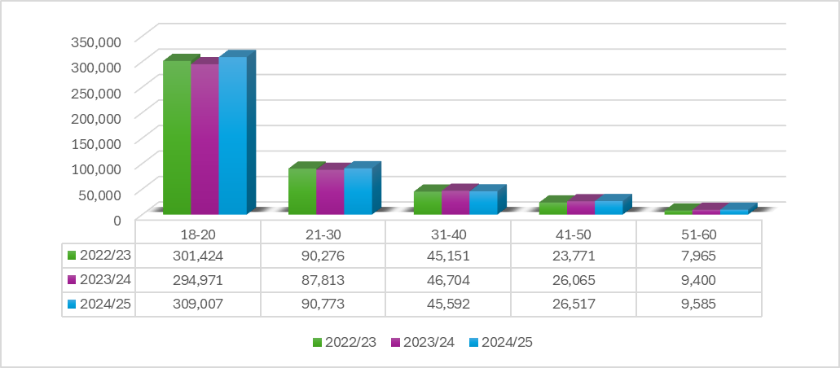
Student Age at Start of Academic Year
The chart below shows us the age of students at the start of the academic Year
Application data YoY comparison (As of 31st March 2025)
Notes:
If a student has had no contact or limited contact (verbal or written) with their biological/adoptive parent(s) & no longer have what they would class as a supportive relationship for any amount of time, they can be assessed as an independent student on the basis of estrangement.
For a limited amount of contact to be considered SLC would need a full explanation on the nature of the contact they have had and this would then be assessed on a case by case basis.
Students who have a legal guardian should also apply as an estranged student.
A legal guardianship / court order would not be sufficient evidence as this does not confirm the current situation with the student’s parents.
The legal guardian is not able to act as a sponsor on the student’s application.
If the student has been legally adopted, then SLC would require their adoptive parents to provide their income details in support of the application.

Slide 31
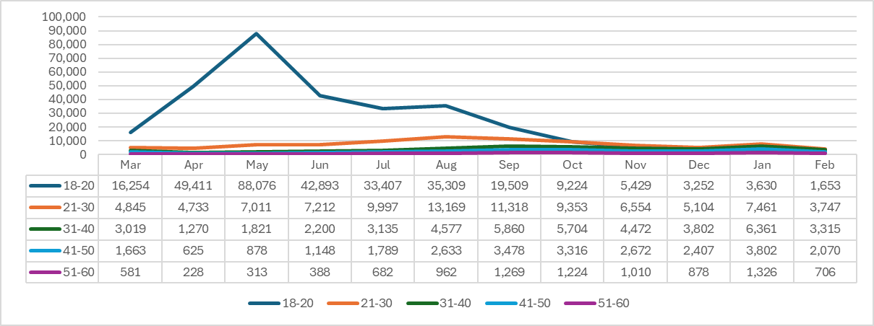
Student Age at Start of Academic Year
The chart below shows us the age of students at the start of the academic Year
Application data YoY comparison (As of 31st March 2025)
Notes:
If a student has had no contact or limited contact (verbal or written) with their biological/adoptive parent(s) & no longer have what they would class as a supportive relationship for any amount of time, they can be assessed as an independent student on the basis of estrangement.
For a limited amount of contact to be considered SLC would need a full explanation on the nature of the contact they have had and this would then be assessed on a case by case basis.
Students who have a legal guardian should also apply as an estranged student.
A legal guardianship / court order would not be sufficient evidence as this does not confirm the current situation with the student’s parents.
The legal guardian is not able to act as a sponsor on the student’s application.
If the student has been legally adopted, then SLC would require their adoptive parents to provide their income details in support of the application.

Slide 32
Student Loan Applications
Supporting Guidance and Resources

Slide 33
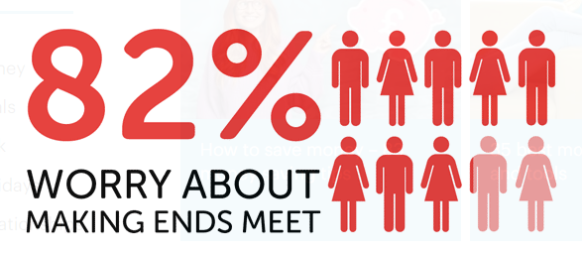
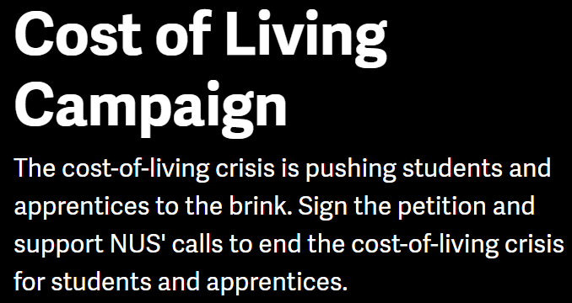
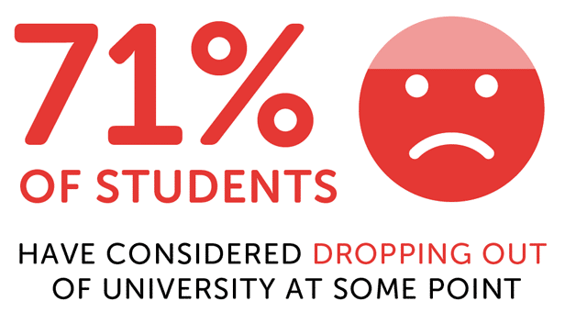
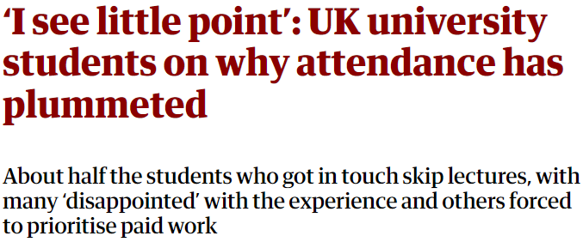
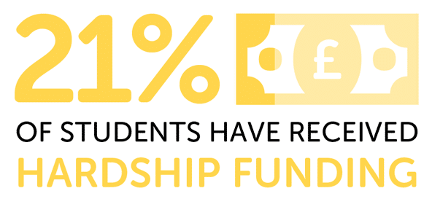
Higher Education in the Spotlight
Press coverage, independent articles, sector body reviews and student finance related campaigns delivered by advocacy groups and organisations have thrown the current student experience into the public eye:
Content from: www.theguardian.com/education/students Savethestudent.org and www.nus.org.uk
Notes:
71% of students in the survey said they had thought about dropping out of university at some point, with the most common reasons being their mental health (59%) and money worries (54%).
Over four in five students in the survey said they worry about making ends meet. This is consistent with the results from the 2022 survey, indicating how little has changed in the last year to improve the situation for students.
Money worries can impact a range of aspects of a student's life. The three most common areas of life that students told us were impacted by their financial issues were their diet (49%), mental health (55%) and social life (62%).
About half of the students who got in touch said they were regularly skipping classes, with many saying they were hardly attending at all.
A lot of students pointed to financial difficulties forcing them to prioritise paid work over studying, a lack of enthusiasm for the format of lectures, low motivation to get up and go in, and the perception that attending classes was unlikely to improve their grades.
More than half of full-time students are working long hours in jobs to support themselves at university, spending nearly two days a week in paid employment during term time, owing to the cost of living crisis.
A survey of 10,000 full-time UK undergraduates by the Higher Education Policy Institute (Hepi) found a record 56% had paid employment while they were studying, working an average of 14.5 hours each week.
Experts said that the lack of maintenance support was creating a two-tier higher education system, with a widening divide between students who need to work long hours to survive while their better-off peers are free to concentrate on their studies and improve their grades.

Slide 34
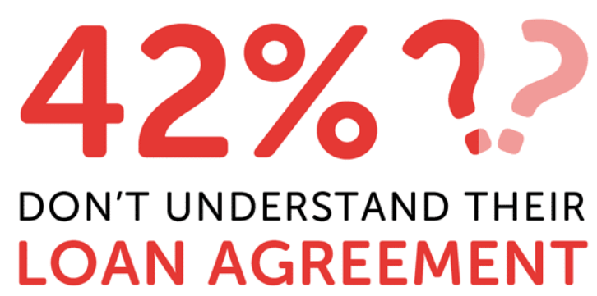
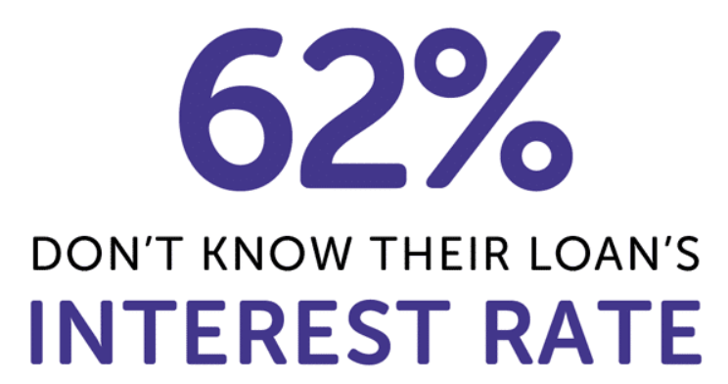
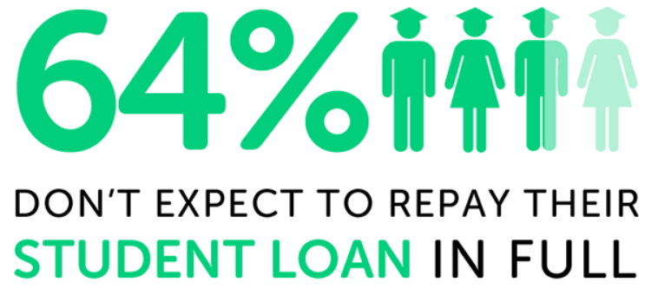
Understanding Student Loans
Many students feel that they are not fully aware of the range of support available or how their loan will work, so encouraging them to do some research and ask questions can help with their understanding:
Figures from Savethestudent.org Student Money Survey
Notes:
In this year's survey, we have seen an increase in the proportions of students who are confused and uncertain about their Student Loans.
This was particularly noticeable when we asked students if they understand their Student Loan agreement.
Among those in the survey who have a Student Loan, 45% said they don't fully understand the loan's repayment terms.
This is up from 40% who said this in the 2020 survey, and 38% who said the same in the 2021 survey.

Slide 35
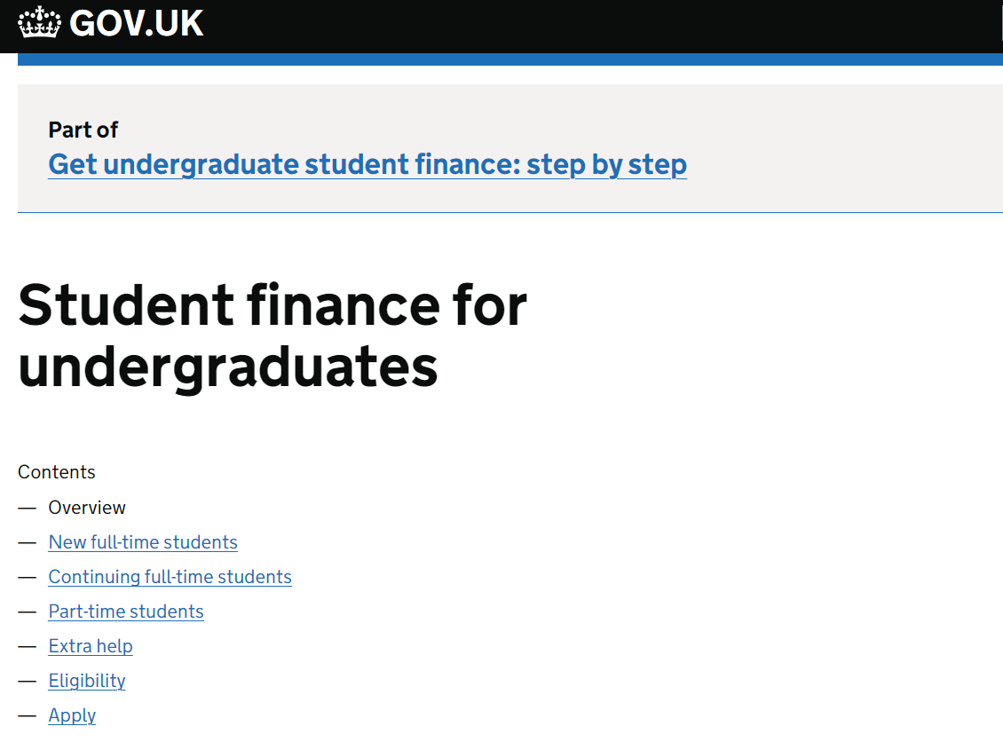
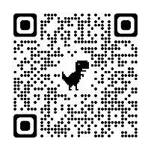
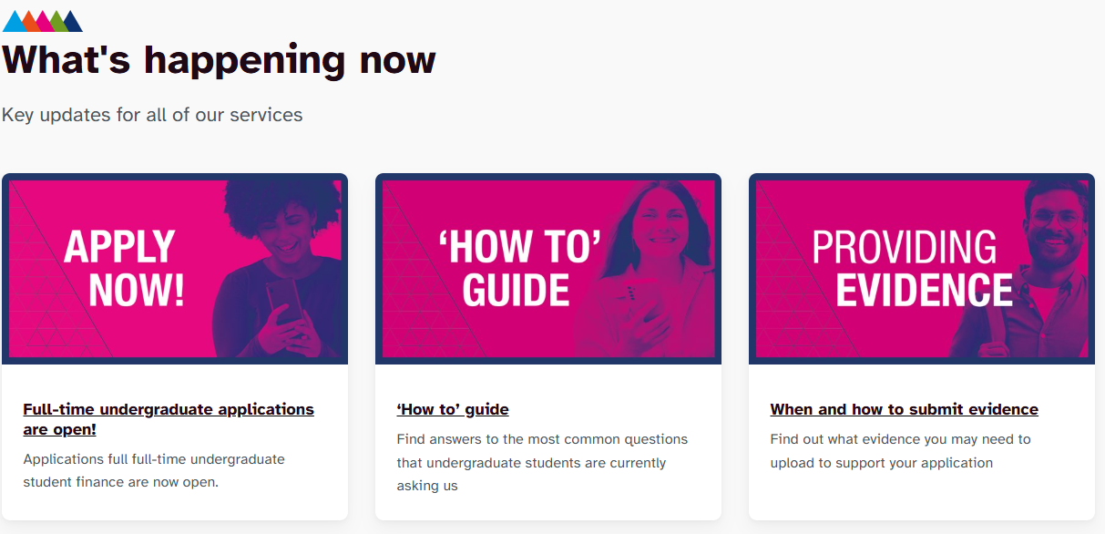
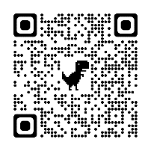
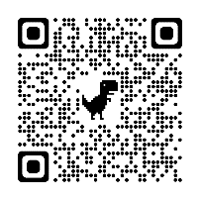
SFE Full-Time Applications: Student Resources
Essential information and guidance about the end-to-end student finance journey can be found on GOV.UK
and across the SFE social media channels. Information for SFW can be found on the SFW site and on social
media channels:
www.gov.uk/student-finance
www.studentfinancewales.co.uk/

Slide 36
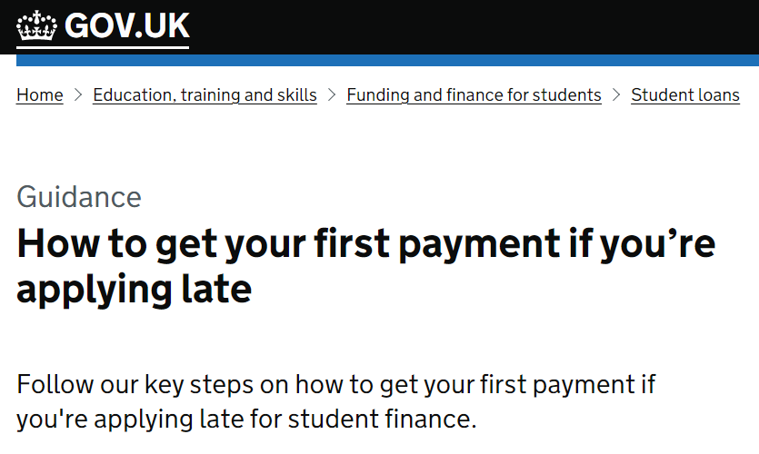
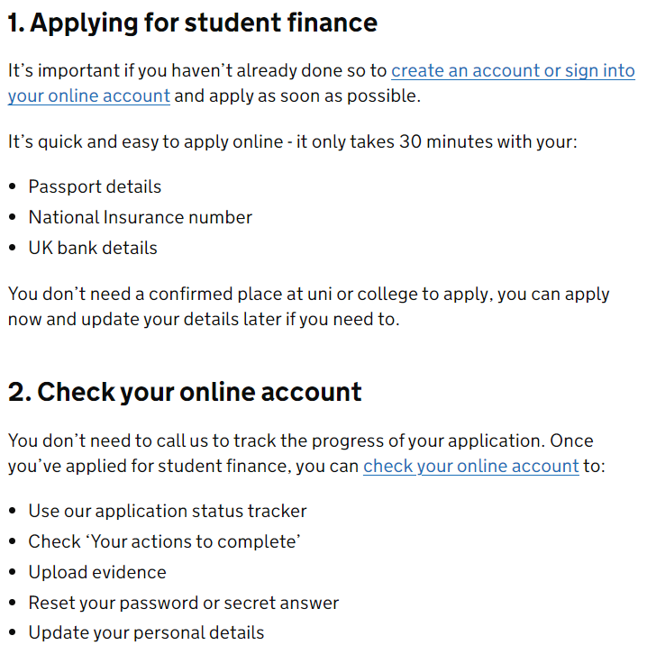
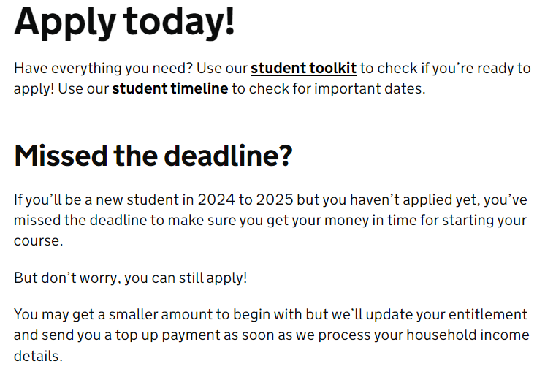
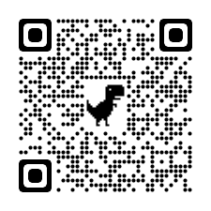
SFE Full-Time Applications: Late Application Support
The AY 2025/26 SFE full-time undergraduate application ‘deadline’ for new students is May 16th.
SFW full time undergraduate application ‘deadline’ for new students is May 23rd
It is important that students who haven’t already done so, apply as soon as possible to make sure they get some money at the start of their course
The SFE campaign page and GOV.UK guidance pages provide essential ‘late application’ messages:
https://studentfinance.campaign.gov.uk
www.gov.uk/guidance/how-to-get-your-first-payment-if-youre-applying-late
Notes:
Full-time undergraduate 2023 to 2024 applications are now open!
It’s quick and easy to apply, it should take less than 30 minutes.
Don’t worry if you’ve missed the new student deadline – there’s still time! Sign in or create an account and apply now!
To make sure you get some money for the start of your course we may award you the minimum amount while we review your application.
Continuing students have until 23 June 2023 to re-apply to make sure your funding is in place for the start of your term. If you apply late, your money might be late!
Find out more about applying late.
EU Tuition Fee only applications for 2023 to 2024 are now open! If you qualify for Tuition Fee only, complete a paper EU Tuition Fee only application form.

Slide 37
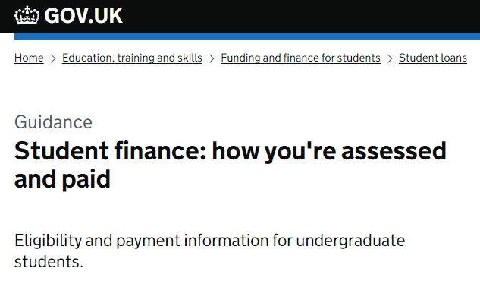
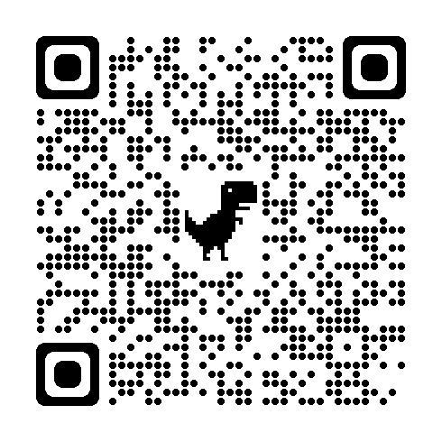
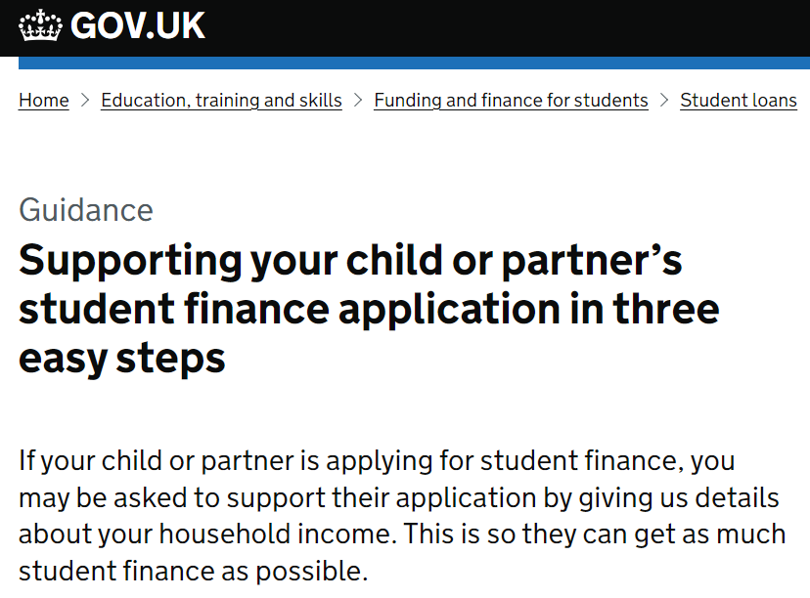
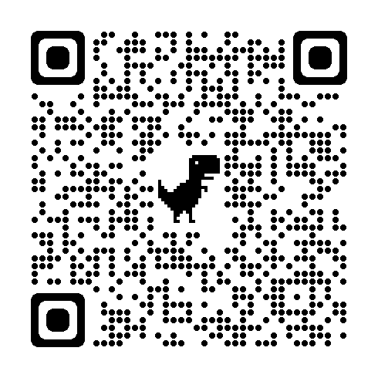
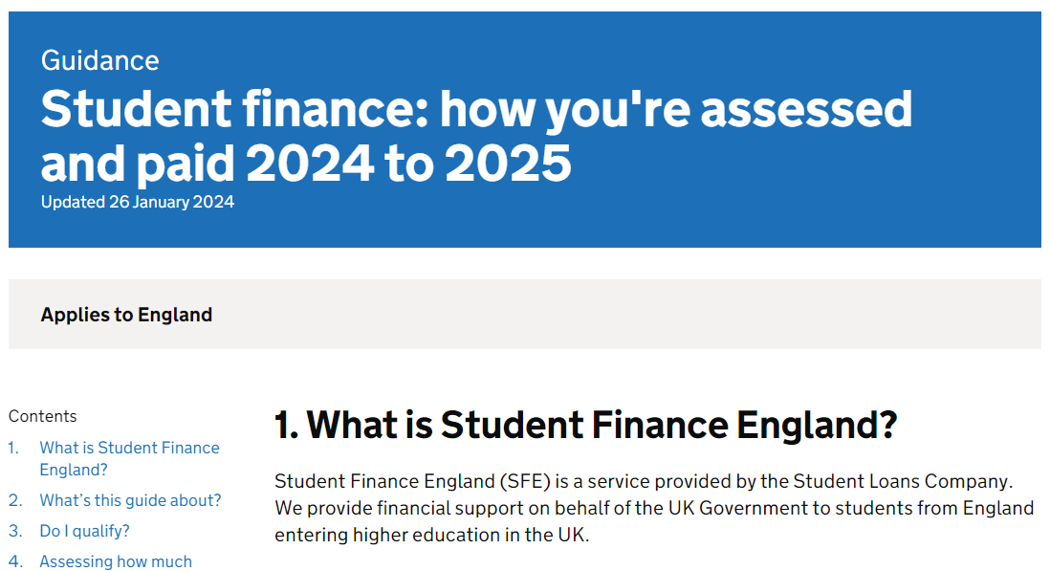
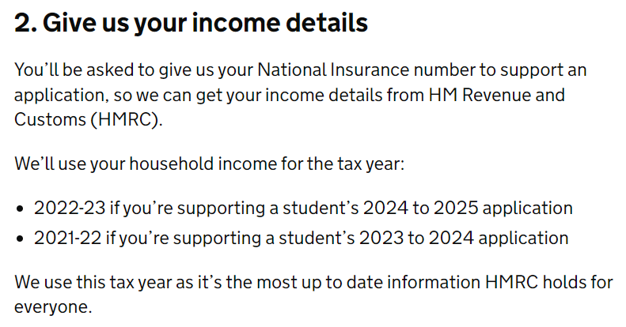
SFE Applications: Sponsor Resources
Detailed information on student finance entitlement, household income assessment, means testing and how
parents and partners can support student finance applications is available on GOV.UK:
Student finance: How you’re assessed and paid guidance
www.gov.uk/government/publications/student-finance-how-youre-assessed-and-paid
Supporting student finance applications guidance
www.gov.uk/guidance/supporting-your-child-or-partners-student-finance-application-in-3-easy-steps
Notes:
https://www.gov.uk/guidance/understanding-living-costs-while-studying-at-university-or-college
If there is more than one dependant child in the same household, a standard allowance of £1,130 is deducted from the household income for each of these additional dependants. If there is more than one student from the same household in higher education (depending on household income) a further reduction may be possible through applying split contributions (expected parental contribution to a students maintenance costs)
For example, in a household with two students and a household contribution of £500, this would be divided between the two students. Where students in the same household fall under different student finance regulations, their household contribution would be calculated according to the regulations which apply to their individual circumstances. The household contribution is then divided by the number of students in that household.

Slide 38
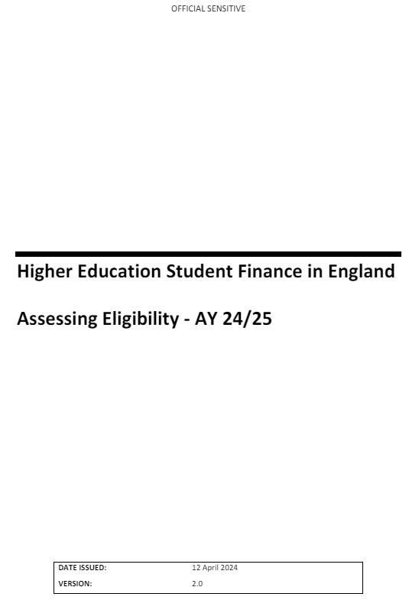
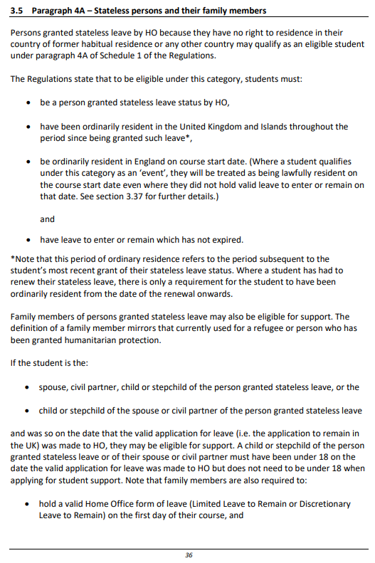
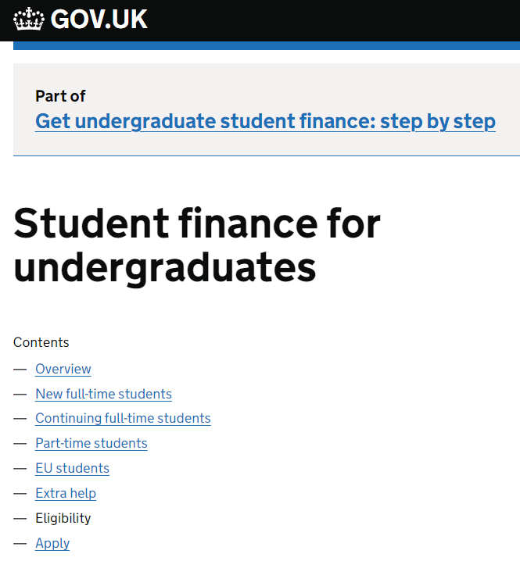
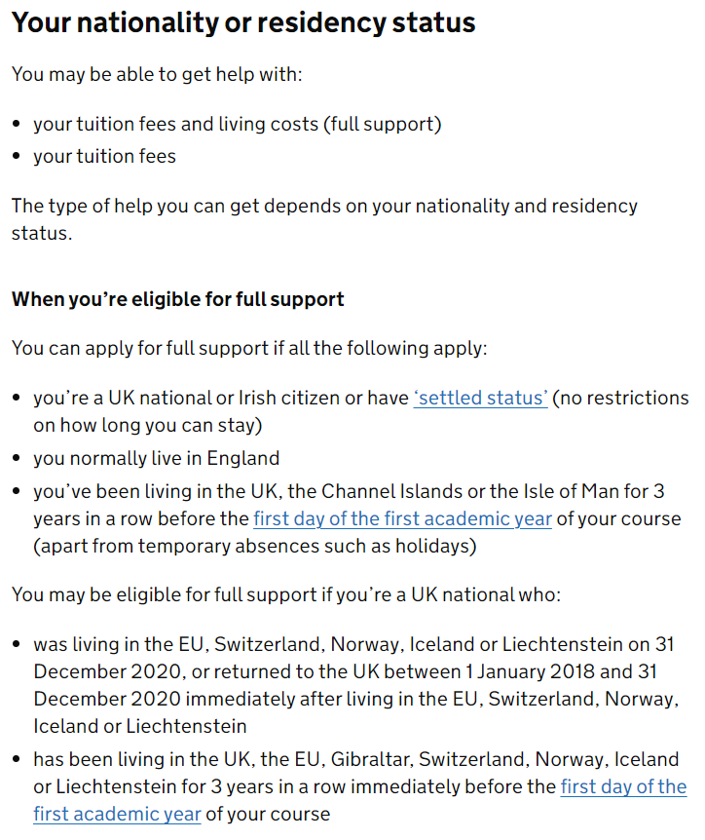
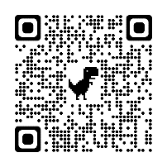
SFE Applications: Eligibility Guidance
Understanding the residency status and requirements to be eligible for student support can be complex,
but guidance is available online:
For practitioners:
SFE Assessing Eligibility Guidance Chapter
www.practitioners.slc.co.uk/policy
For students:
General eligibility guidance on GOV.UK
www.gov.uk/student-finance/who-qualifies
Notes:
Understanding the residency status requirements to be eligible for student support can be complex, but guidance is available online:
For practitioners: SFE Assessing Eligibility Guidance Chapter
www.practitioners.slc.co.uk/policy
For students: General eligibility guidance on GOV.UK
www.gov.uk/student-finance/who-qualifies

Slide 39
Student Finance Information: Other Domiciles
Eligibility, entitlement and application information and guidance is also readily available from the websites and
social media channels supporting the other UK funding administrations:
Student Finance Wales:
Website: www.studentfinancewales.co.uk
Facebook: facebook.com/SFWales
X: https://x.com/SF_Wales
YouTube: youtube.com/user/SFWFILM
Student Finance Northern Ireland:
Website: www.studentfinanceni.co.uk
Notes:
Understanding the residency status requirements to be eligible for student support can be complex, but guidance is available online:
For practitioners: SFE Assessing Eligibility Guidance Chapter
www.practitioners.slc.co.uk/policy
For students: General eligibility guidance on GOV.UK
www.gov.uk/student-finance/who-qualifies

Slide 40
Student Money Management: Useful Information
Useful sources of student money management and budgeting information include:
GOV.UK: www.gov.uk/student-finance
Understanding Living Costs guidance page
Discover Uni: https://discoveruni.gov.uk
Dedicated student money section
Save the Student: www.savethestudent.org
Advice and resources including money and accommodation surveys
Money Saving Expert: www.moneysavingexpert.com/students
Information, opinion, blogs and budgeting advice
i
Many university and college websites will feature helpful student finance and budgeting
guidance, knowledge of local costs and details of their bursary and scholarship offers
Notes:
Links in text
https://www.gov.uk/guidance/understanding-living-costs-while-studying-at-university-or-college
https://discoveruni.gov.uk/how-will-i-pay-for-it/
https://www.savethestudent.org/student-finance
https://www.moneysavingexpert.com/students/
https://www.thisismoney.co.uk/money/studentfinance/article-1633418/Student-budget-calculator-spend-fund-it.html

Slide 41
Questions or Comments
Notes:
Any questions for me?

Slide 42
Stephen Jones & Stacey-May Fox
Funding Information Services Account Manager
Stephen_jones@slc.co.uk Stacey-May_Fox@slc.co.uk
www.gov.uk/slc

