Slide 1

Preparing our students for success with pre-entry financial education
NASMA Campaigns Committee
August 2024

Slide 2
Key financial education issues
64% of students feel that the financial education they had at school was inadequate, and 49% expect universities to offer financial education
85% of students are worried about money, and 54% of students say it negatively impacts their mental health
1 in 10 students have never created a budget for university
NASMA members share UK-wide concerns around financial capability skills and expectations of financial support at university
Data sourced from the National Student Money Survey 2023 and Blackbullion Money & Wellbeing Report 2024

Slide 3
Key financial education issues
“Financial education is crucial for 16-to-18 year-olds, many of whom are transitioning into the workplace, paying taxes, considering applying for a student loan, and living away from home for the first time. Yet it is post-16 students who miss out on any form of compulsory financial education.”
Delivering Effective Financial Education (Paragraph 28)
House of Commons Committee – May 2024

Slide 4
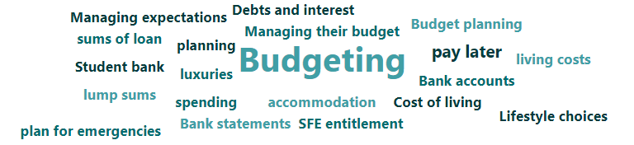
Key messages applicants need to know
Suggestions from members:

Slide 5

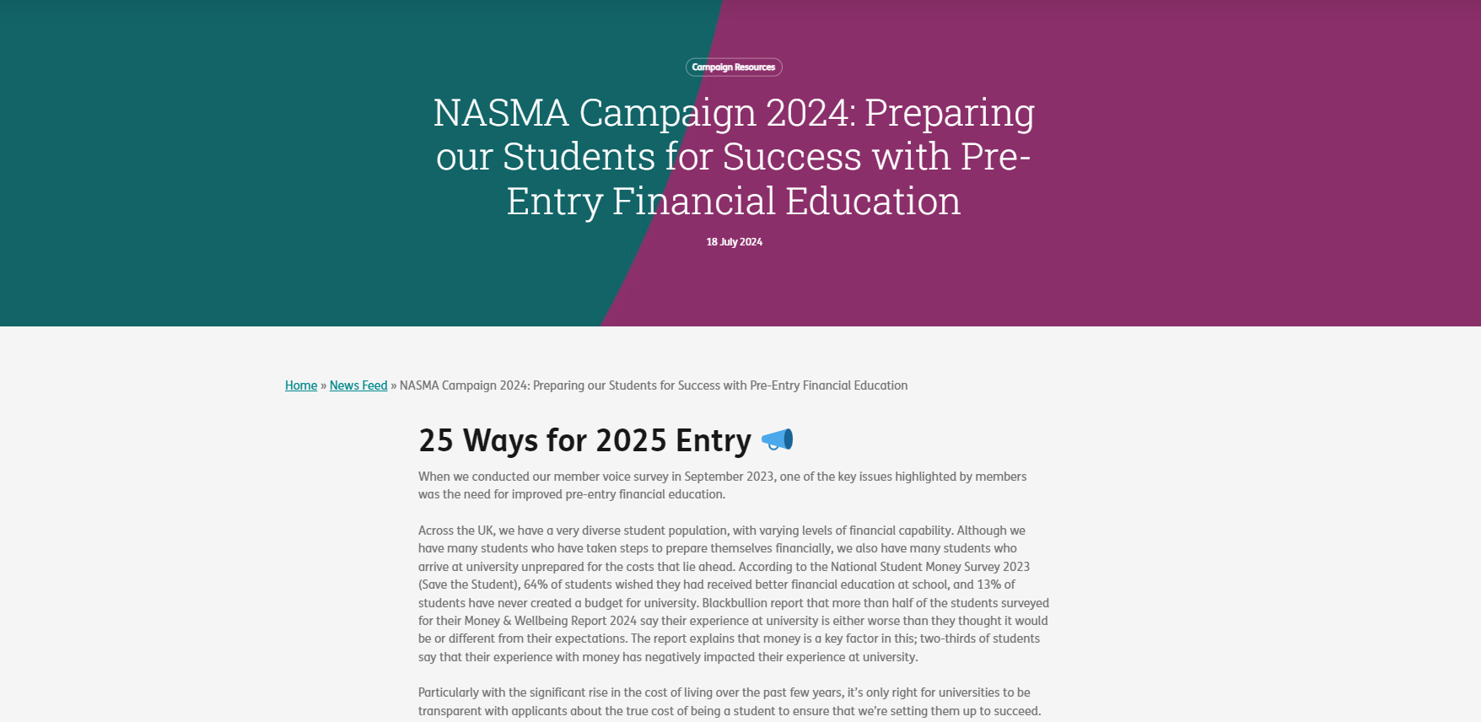
25 ways to prepare your 2025 applicants
We have taken things back to basics
We understand the financial and staffing resource pressures across the UK Higher Education sector, and will be highlighting ways to reduce the burden
Ultimately, the more financially prepared our applicants are, the less support they will need once they enrol

Slide 6

Build relationships with recruitment and outreach teams
Build relationships with applicant-facing teams
  Recruitment
  Outreach
  School liaison
  Applicant communications
  Social media
Organise time together to learn about team remits and priorities, including any challenges teams are facing
Identify ways to work collaboratively to resolve challenges
Schedule catch ups across the academic year to review

Slide 7
Develop applicant communications plans
OPEN DAY REGISTRATION
PRE-OPEN DAY COMMS
OPEN DAY ITINERARY
OPEN DAY FOLLOW UP
APPLICATION COMMS
APPLICANT NURTURE TRACK
VISIT DAY COMMS
PRE-ARRIVAL COMMS
ENROLMENT
Collaborate with your applicant communications teams to develop a money communications plan across the applicant journey
Include a variety of multi-media platforms; for example, YouTube videos, social media posts, Tik Tok, Instagram stories, email and blogs, considering how different platforms might be best for disseminating different information and updates
Consider what information different types of applicant would need at different intervention points

Slide 8

Become student voice informed
Speak to current students to understand more about what they wished they had known about money before they arrived and how they would have liked to find out about it
You could use surveys, post-it note boards, or social media
Ask your Student Union for help in engaging students, or ask them to directly source student input
Use this information to help shape your plans for pro-active interventions and to help to promote it too

Slide 9

Use expertise as an incentive
Help your school liaison team to get buy-in from key local schools and FE colleges by offering your services as a student money expert
If there are local FE colleges offering Access courses, offer their cohort an information session tailored to Access students progressing to HE
If staffing resource is a problem, you could pre-record a digital talk or ask your school liaison teams to deliver it on your behalf. The main message to get across is preparing for realistic student living costs.

Slide 10

Make your money webpages stand out
Liaise with your web team to make your student money webpages more accessible
Create an online hub for student living costs information
Include transparent and realistic examples of student living costs, and targeted advice for diverse cohorts
Image sourced from Birmingham City University webpages.

Slide 11
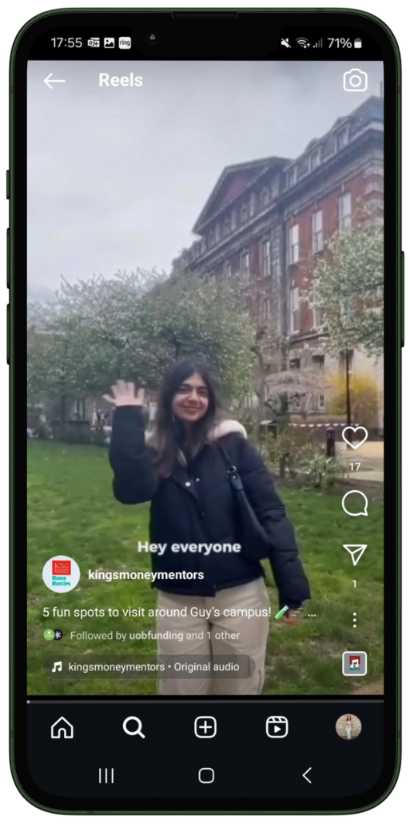
Engage current students
Ask current students to share their own experiences
Your pool of student ambassadors could be a great place to start
Applicants can often find it easier to relate to current students rather than staff
Include a diverse range of students and, where appropriate, tailor tags and titles based on student groups as applicants will often search for key words online
Image sourced from Instagram: Kings Money Mentors (Kings College London)

Slide 12
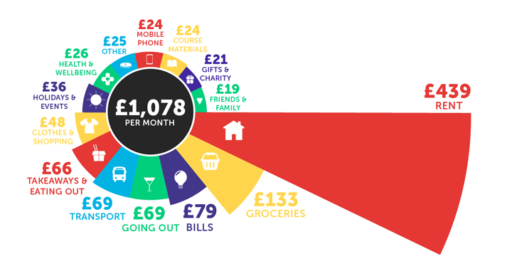
Embed real-world living cost data
Link to National Student Money Survey results from webpages and social media
Use real-world data to demonstrate realistic living costs
Use the data to provide examples of budgets
Be sure to include tips on local variances
Turn the data into interactive activities
You could also use:
  Natwest Student Living Index
  STS National Student Accommodation Survey
Data sourced from the National Student Money Survey 2023 (Save the Student).

Slide 13





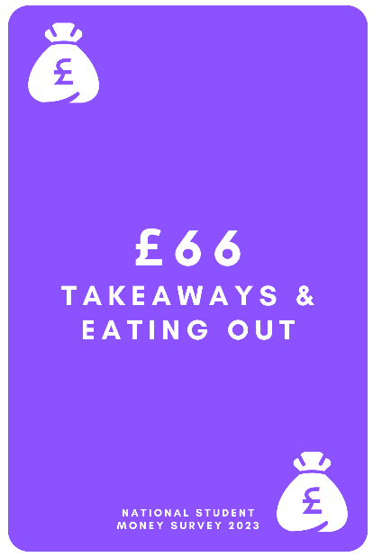

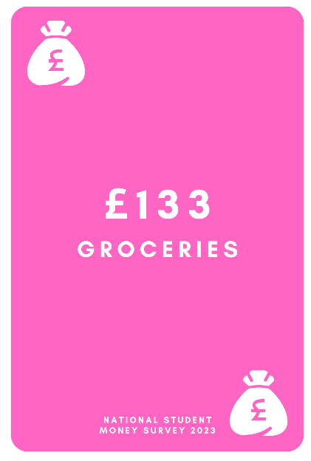

Embed real-world living cost data
Our Higher or Lower interactive table-top game is available to download, with instructions, from the NASMA Member Portal.
Data sourced from the National Student Money Survey 2023 (Save the Student).

Slide 14













Embed real-world living cost data
£25
£50
£75
£100
£200
£300
£400
£500
£600
£700
Our You VS The Average interactive table-top game is available to download, with instructions, from the NASMA Member Portal.
Data sourced from the National Student Money Survey 2023 (Save the Student).

Slide 15
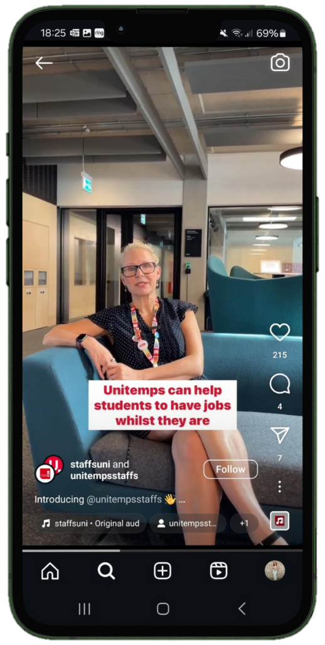
Normalise part-time student jobs
Encourage careers teams to offer part-time job support services for students and highlight this service to applicants
Include info on part-time jobs at Open Days, on webpages and social media, highlighting key timescales of when to apply for local part-time jobs
Work with careers teams to plan part-time jobs fairs with local employers during the pre-arrival and induction period
Use real-world data to encourage students and applicants to consider part-time work:
  56% of students have a part-time job
  Students with part-time jobs earn an average of £544 per month
Data sourced from the National Student Money Survey 2023, image sourced from Instagram: Staffs Uni.

Slide 16



Normalise part-time student jobs
Videos sourced from YouTube: University of Manchester & Birmingham City University.

Slide 17
Encourage accommodation teams to provide info on cheaper external options
Most students will want to live in university accommodation in their first year regardless
Providing info about cheaper options can help applicants to compare, make an informed decision and plan for future years
Include information about checking whether rent is inclusive or exclusive of bills
For students who pay energy bills separately to rent, they are paying an average of £86 per month
Average monthly rent and data sourced from the National Student Accommodation Survey 2024 (Save the Student).

Slide 18
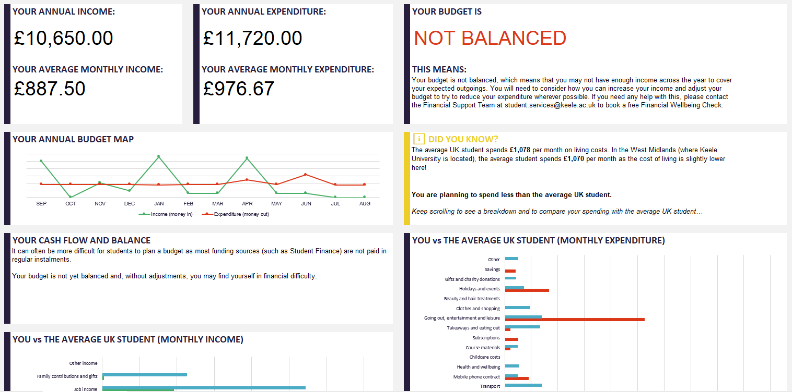
Develop free budget planners
Develop a free, downloadable, meaningful budget planner
Build in visual comparisons between estimates and reality
Include calls-to-action and contact details for support
Our free pre-coded template budget planner is available to download from the NASMA Member Portal
Developed by Keele University.

Slide 19
Manage expectations of institutional support from the offset
Manage expectations of applicants around the types of institutional funding available to them
There has been a significant increase in applications to institutional hardship funds across the UK, with many students applying within the first month of starting their course
Be clear from the offset around the difference between bursaries and hardship funds so that applicants understand what to expect when applying for various institutional funds
You might want to develop communications around how to apply for bursaries, scholarships and support funds to draw attention
Keep in regular contact with your student comms team to ensure that everyone is using the same, clear communications

Slide 20
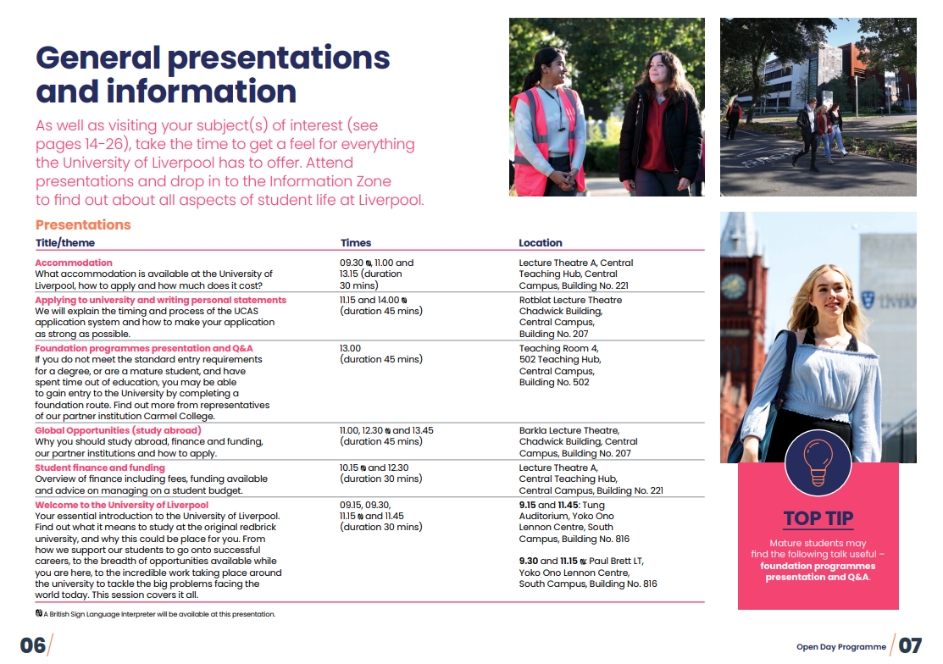
Make ‘student money’ a key Open Day talk
Offer to deliver a student money talk at every undergraduate and postgraduate Open Day and Visit Day
Include information about funding available and the expected parental contribution
Set realistic expectations of income sources and living costs
Make these talks as interactive and engaging as possible, and avoid information overload

Slide 21

Be flexible where it really matters
Offer online, evening student money talks or drop-in services aimed at mature applicants who may be working 9-5 and unable to attend an Open Day
Target applicants aged 21 or over, using applicant data from your recruitment teams
Include tailored information and, if possible, ask current mature students to come along and share their own experiences of managing money as a mature student at university
You might want to record a live version and host this on your institutional YouTube channel for on-demand viewing

Slide 22

Target parents of young adult students
Offer online, evening student money talks aimed at parents of applicants, particularly during Spring when Student Finance applications are open
Include information about the expected parental contribution
You could collaborate with your wellbeing teams to include general information about supporting their children at university and to share delivery responsibilities
You might want to record a live version and host this on your institutional YouTube channel for on-demand viewing

Slide 23
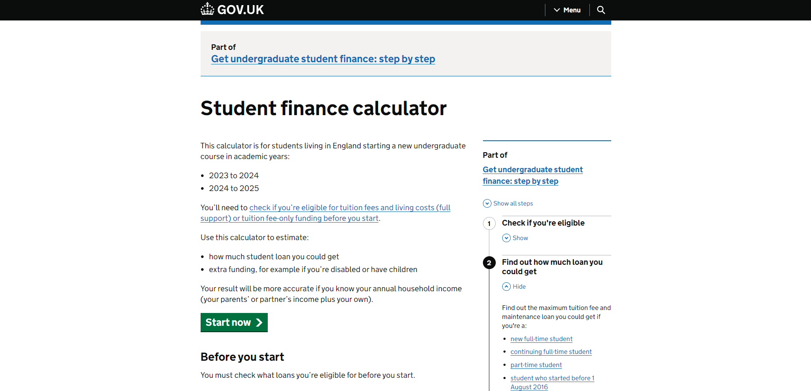
Promote informed accommodation decisions
Ask your accommodation team to encourage applicants to find out how much funding they can get before making accommodation decisions
Include links to funding body webpages (such as the Student Finance Calculator)
Include reminders of other costs the maintenance loan needs to contribute to
Image sourced from UK Government website.

Slide 24
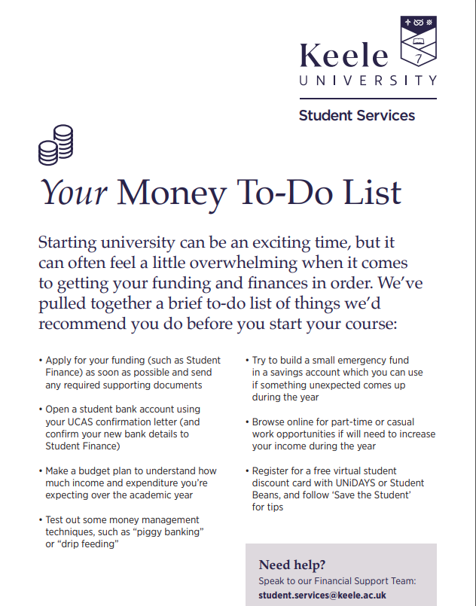
Develop meaningful resources
Develop meaningful and sustainable resources which applicants can take away
Be mindful of environmental impact, while considering what resources would be useful for applicants to have in paper format
Ensure resources are concise and accessible
Avoid information overload at all cost
Include a call to action and contact details for support
Image sourced from Keele University.

Slide 25

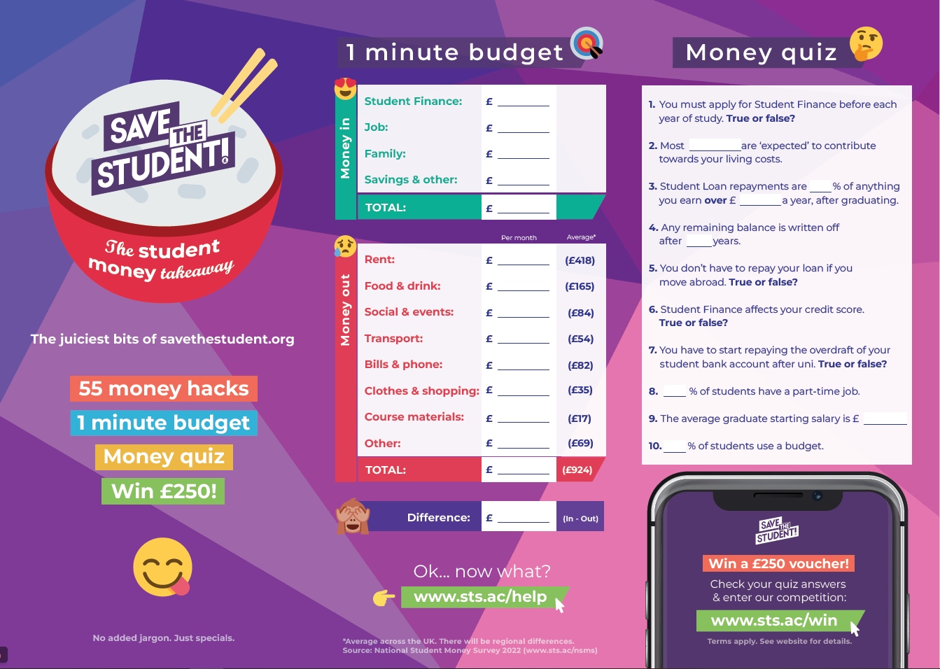
Make use of free resources to reduce cost
If you have a limited budget for designing and printing your own resources, take some time to scout out and order some free options from reputable external sources
A great example is the Student Money Takeaway leaflet from Save the Student
Ideally get in touch in advance of when you plan to use them to enable organisations to take advantage of bulk order price reductions

Slide 26

Offer 1-2-1 applicant appointments
Offer 1-2-1 applicant student money advice appointments
Use Microsoft Teams or Zoom
Although it may seem like additional pressure on workload, hopefully every applicant you support at this stage will be one less student facing financial difficulty later down the line

Slide 27

Target final year undergraduates
Arrange postgraduate funding sessions for final year undergraduates, ideally timetabled into the course itself
Postgraduate funding differs significantly from undergraduate, and this is a great way to ensure that students who may soon become postgraduate applicants have the information they need to help them to plan
By targeting students early, you can influence how they might use their vacation periods to build up savings
Work with academic schools and postgraduate recruitment teams, targeting schools with high Hardship Fund rates

Slide 28
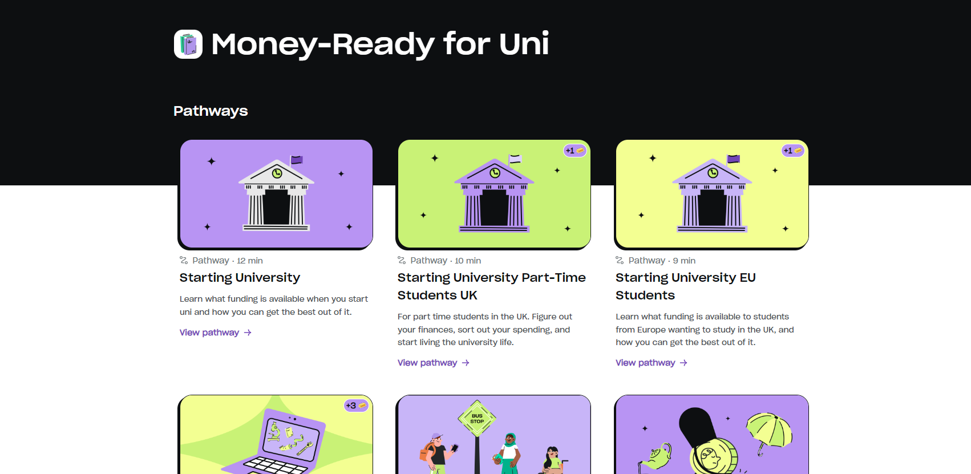
Promote applicant-specific financial education platforms
Explore opportunities for applicant-specific, on-demand financial education platforms or programmes
You could create your own series of on-demand learning resources, or might decide to outsource
One example is Blackbullion ‘Money-Ready for Uni’
Consider sharing cost with your recruitment and outreach teams
Image sourced from Blackbullion platform.

Slide 29
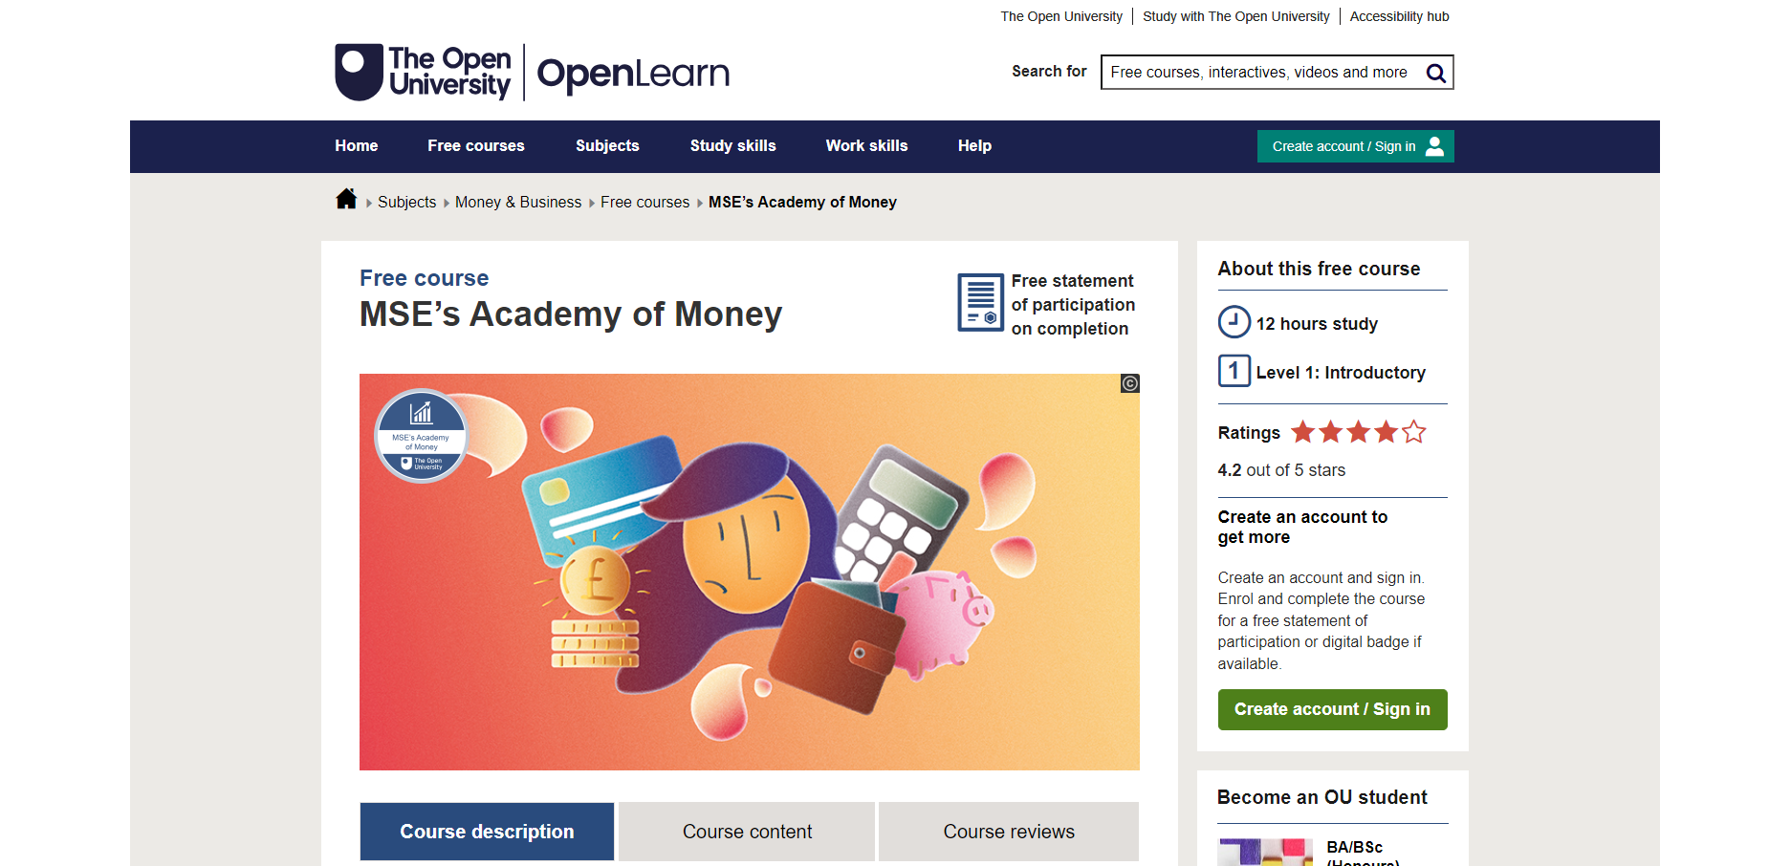
Promote applicant-specific financial education platforms
The Money Saving Expert x Open University: Academy of Money course is completely free and a great resource for general financial capability
Money Saving Expert also has a student hub on its own website which contains lots of useful information
It can be useful to use well-known names, particularly with mature students
Image sourced from Open University. Other programmes are available such as Natwest Money Sense, and the HSBC Young Adult Hub.

Slide 30

Embed funding prompts in Clearing scripts
Ask admissions teams to include prompts about funding applications in Clearing phoneline scripts
Adding a quick question of 'Have you already arranged your funding for your tuition fees and living costs?' can give applicants a timely nudge to complete their funding application or start one if they have forgotten
Scripts could also include branching to ask if they need any help with their application or planning for their finances
Data gained from this can be very useful in targeting support

Slide 31

Include money workshops in pre-arrival transition programmes
Consider planning pre-arrival transition events in the run up to the start of the course (between Clearing and mid-September is usually a good time) in collaboration with your wellbeing teams and use this as an opportunity to talk about money
Ask current students to come and share their experiences and advice
Encourage applicants to share their hopes and fears about money, fostering a judgement-free environment
Introduce yourselves in person and start to break down barriers

Slide 32
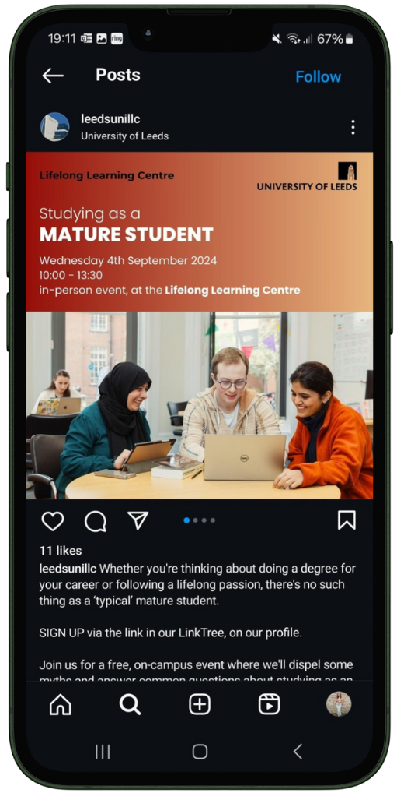
Tailor info and activities where possible
Include tailored online information and pre-arrival webinars for students from key groups
This should include tailored advice, information about additional funding and potential additional costs or loss of income
Be mindful of how different student groups might like to receive information and consider appropriate wording
Be flexible with timing of webinars and, where possible, make them available on-demand
Image sourced from Instagram: Leeds Uni Lifelong Learning Centre.

Slide 33
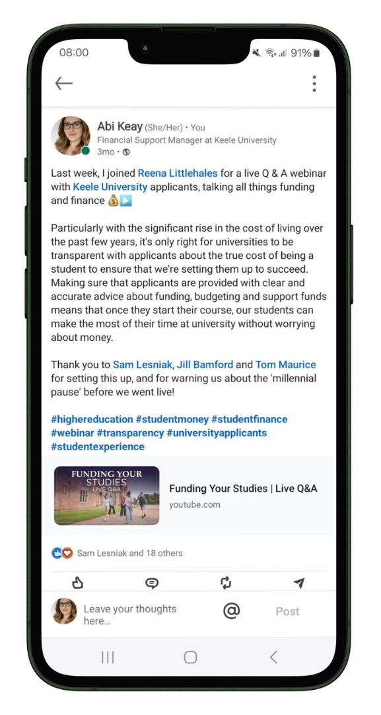
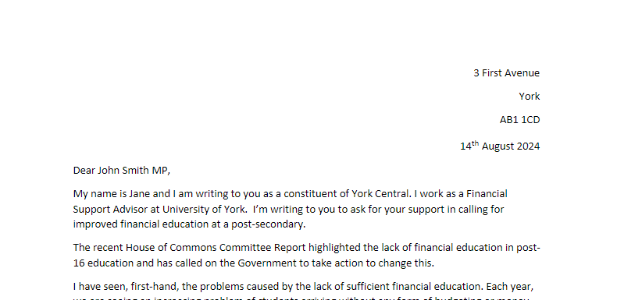
Use your spheres of influence
Post and share your experiences on social media
Highlight to senior leaders
Speak with friends and family
Speak with community groups
Write to your MP
Support financial education initiatives

Slide 34
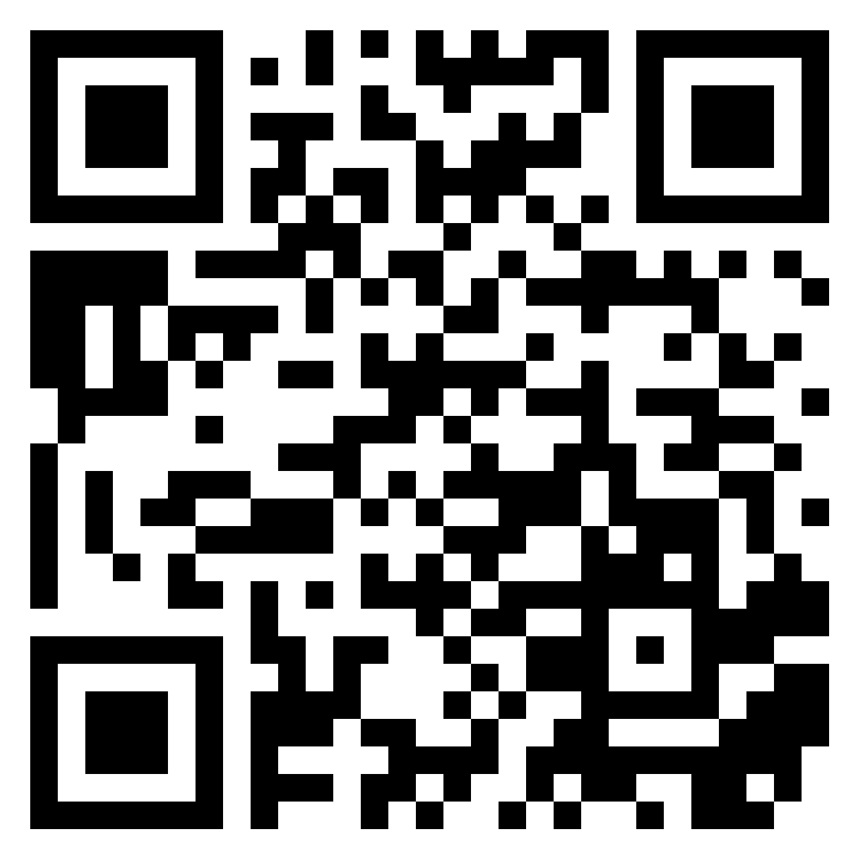
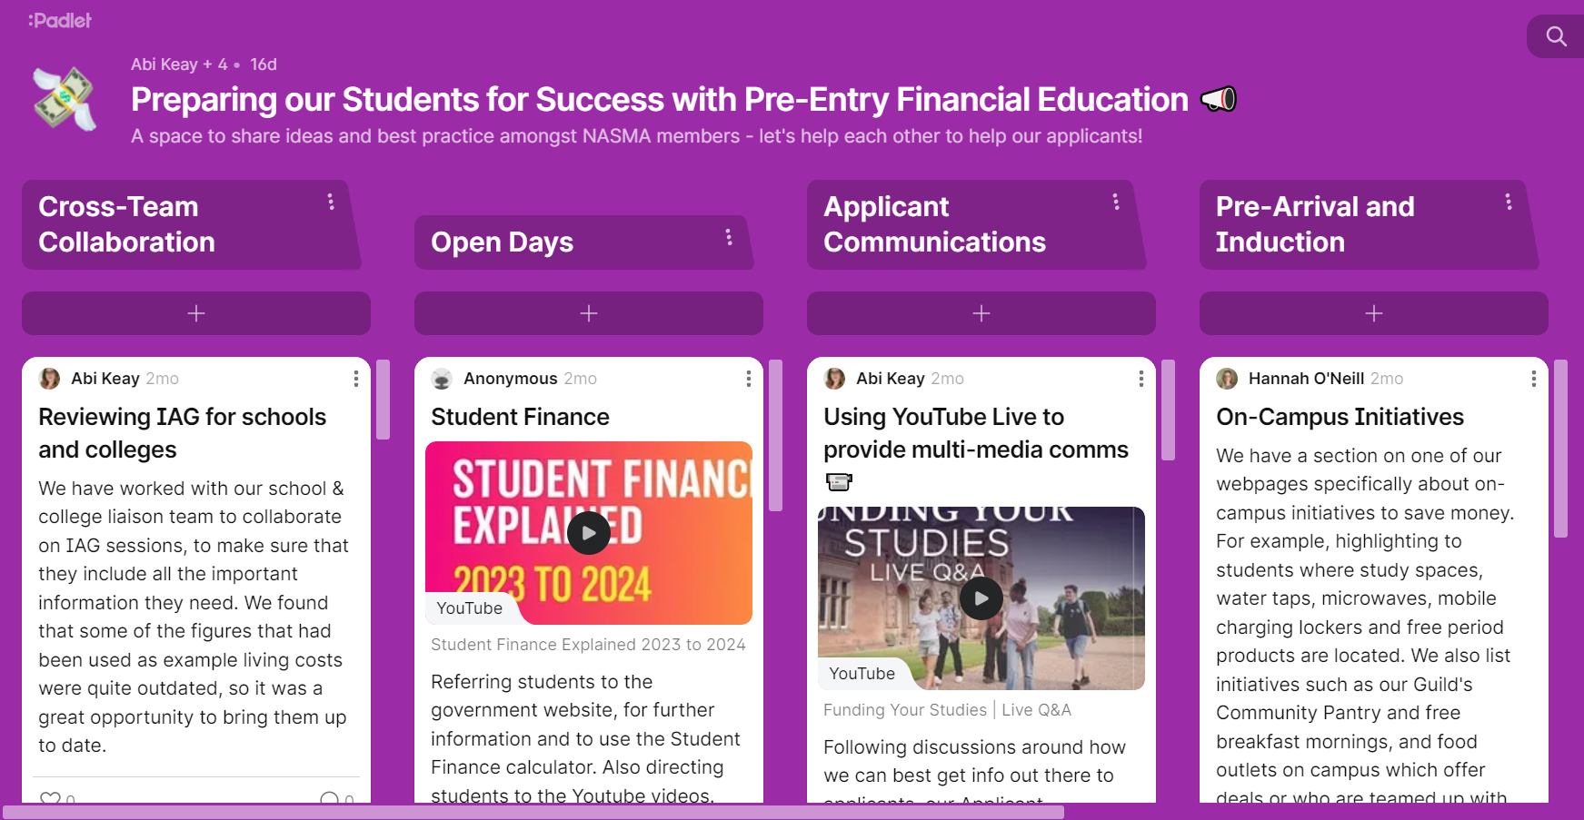
Share your experiences with others
Scan here
Head over to our campaign Padlet to share your experiences and share best practice.

Slide 35
Thank you
www.nasma.org.uk
If you have any suggestions for further resources, please contact our Campaigns Coordinator, Abi, at a.keay@keele.ac.uk

